Slide 1
Describing and modelling E. coli growth
By Tobias Pfennig

Slide 2
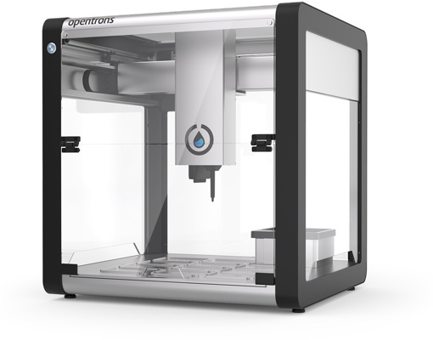
Index
Comprehensive measurement
BioLector Pro
Data in graphs
Supportive measurement
Drymass
Biomass: Scatter vs. Riboflavin
Monod model
Metabolism
Acetate Problems
Future outlook
https://www.opentrons.com/ot-2

Slide 3
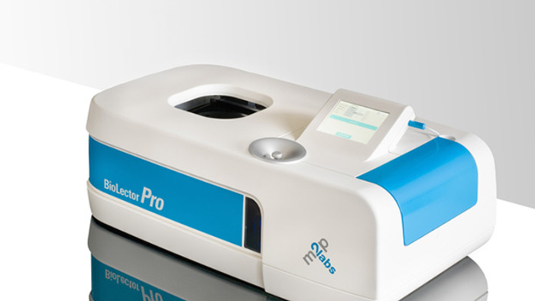
BioLector® Pro
m2p-labs
https://www.m2p-labs.com/bioreactors/products/biolector-pro/

Slide 4
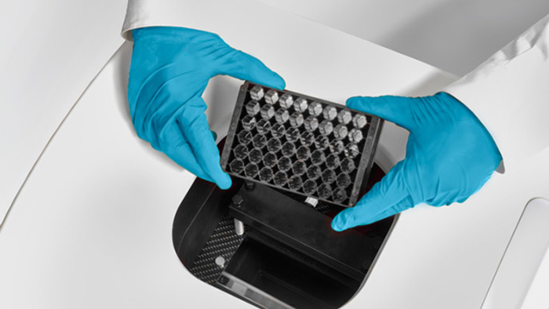
BioLector Pro
Culture measurement
48-well „Flower“-Plates
Regulated humidity, temperature, shaking, …
Optical measuring:
Backscatter
Riboflavin fluor.
O₂ saturation
NADH flour.
pH
https://www.m2p-labs.com/bioreactors/products/biolector-pro/

Slide 5
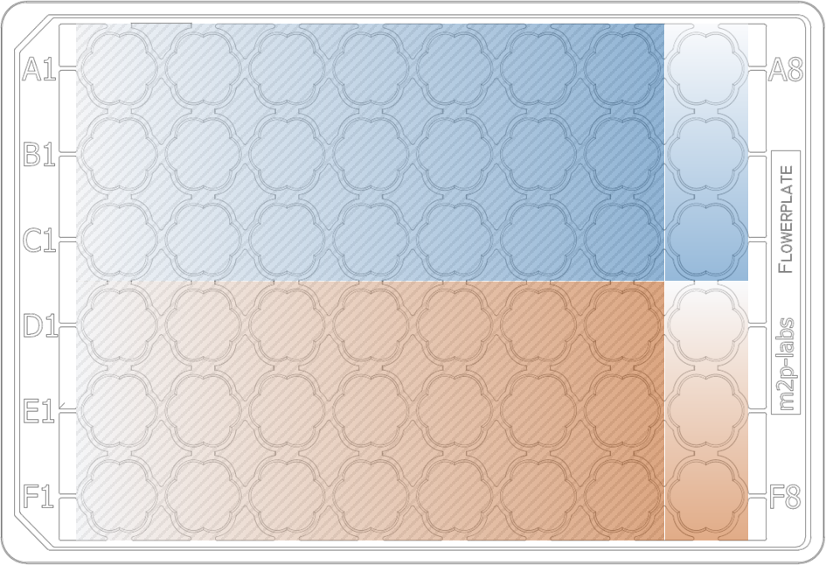
Plate Setup
Two gradients, 3 replicates
Glucose
0 C-mmol/l
133 C-mmol/l
Acetate

Slide 6
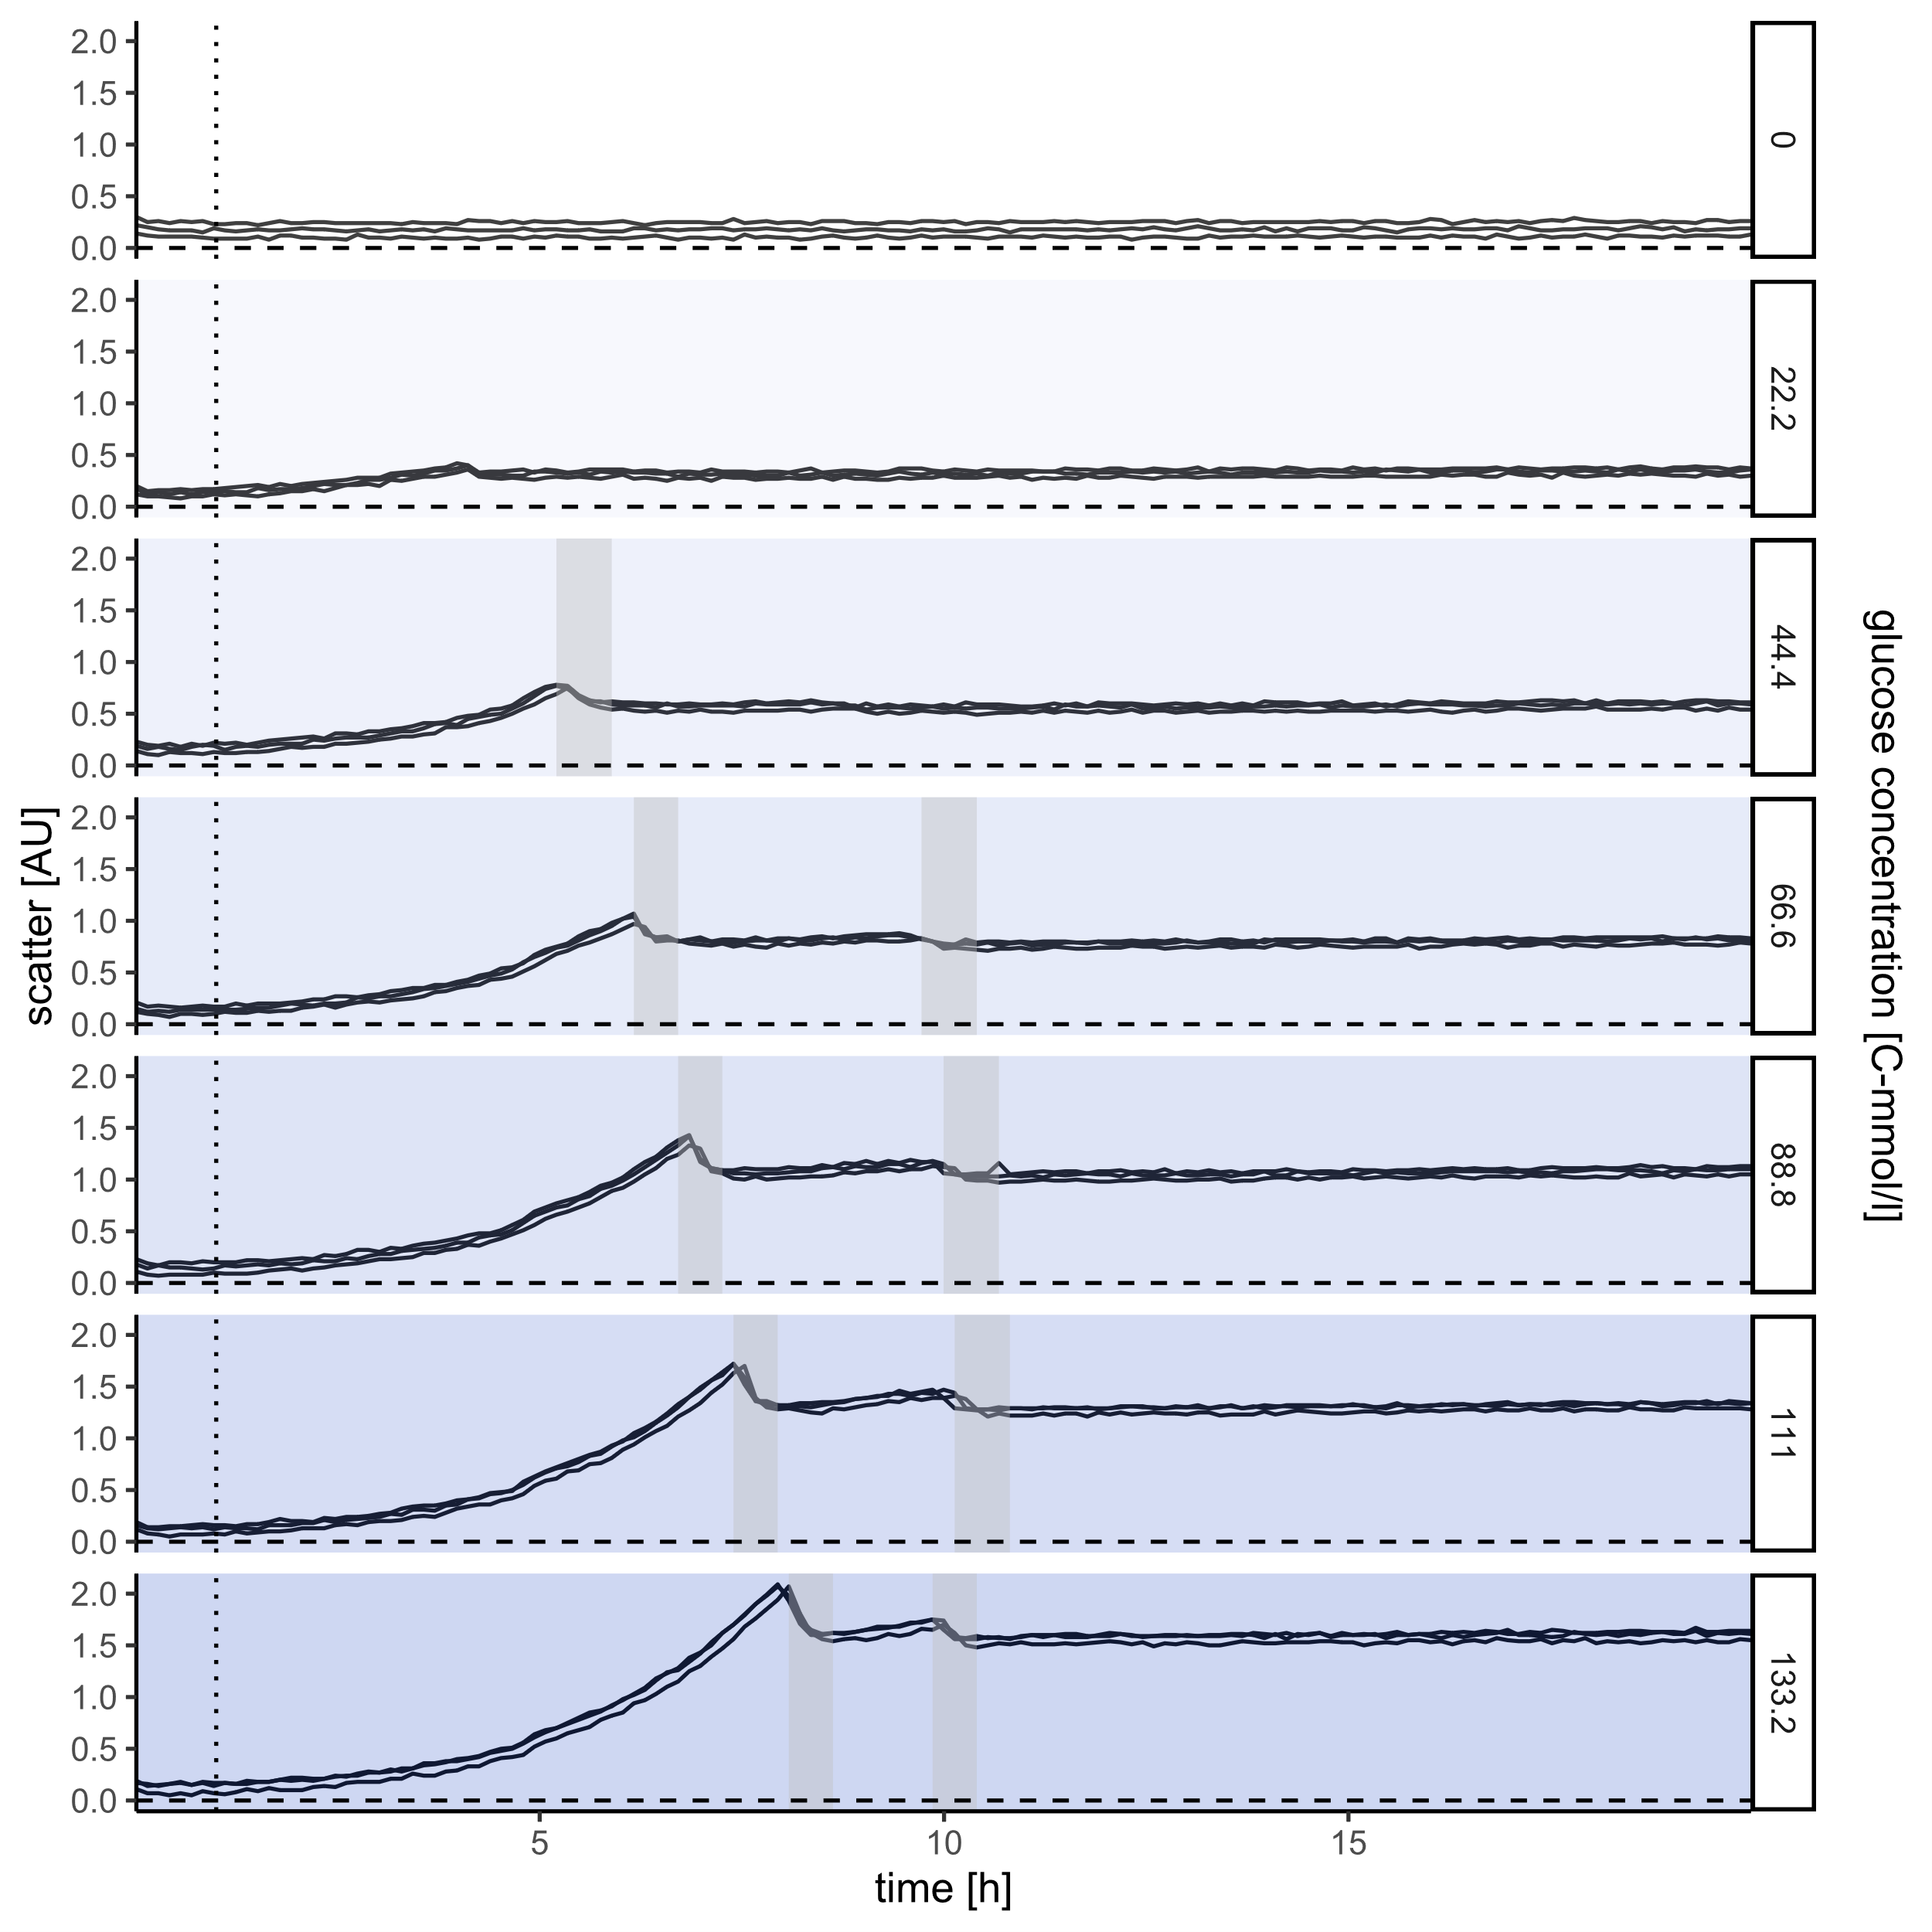
Glucose: Scatter
Scatter vs. time
Surprising drops
Similar initial growth
Drop after variable time
Second, weaker growth
Second drop after similar time
Stationary

Slide 7
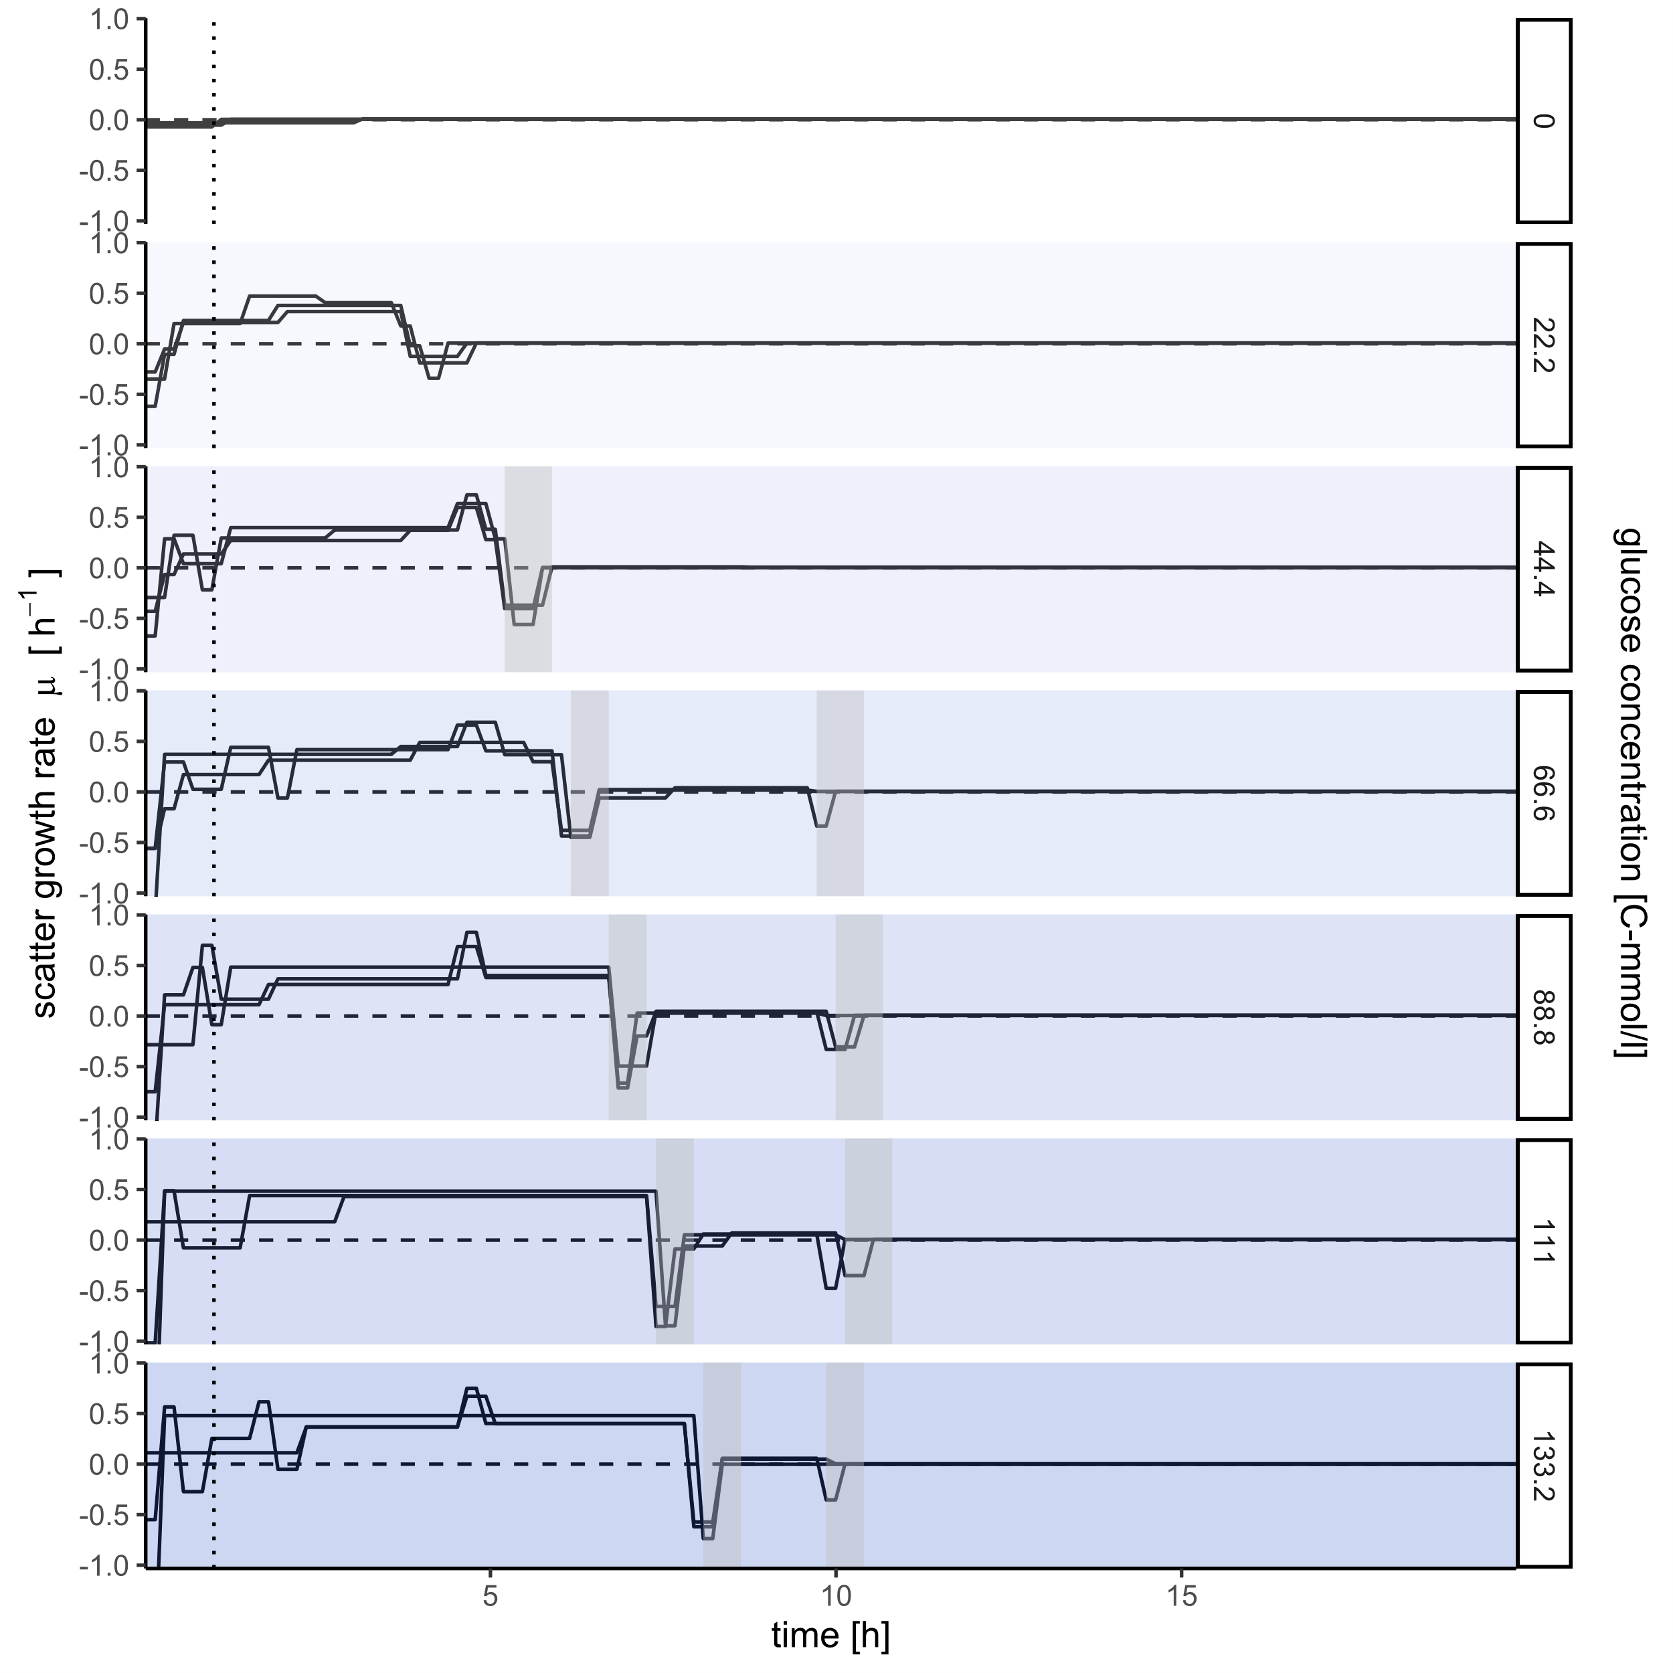
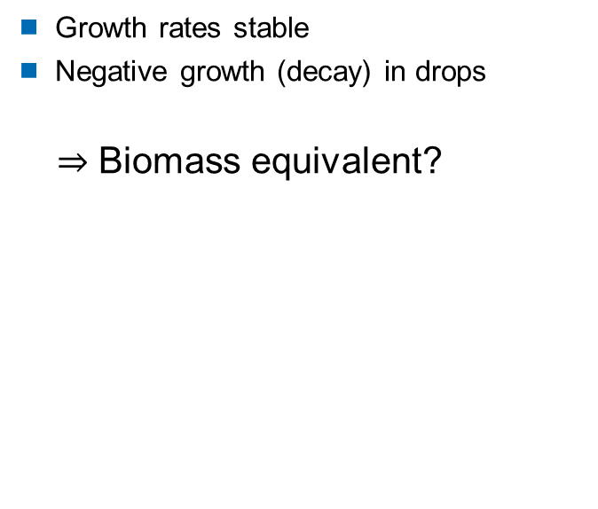
Glucose: Scatter
Scatter growth rates vs. time
Mass decay?
Growth rates stable
Negative growth (decay) in drops
$⇒$ Biomass equivalent?

Slide 8
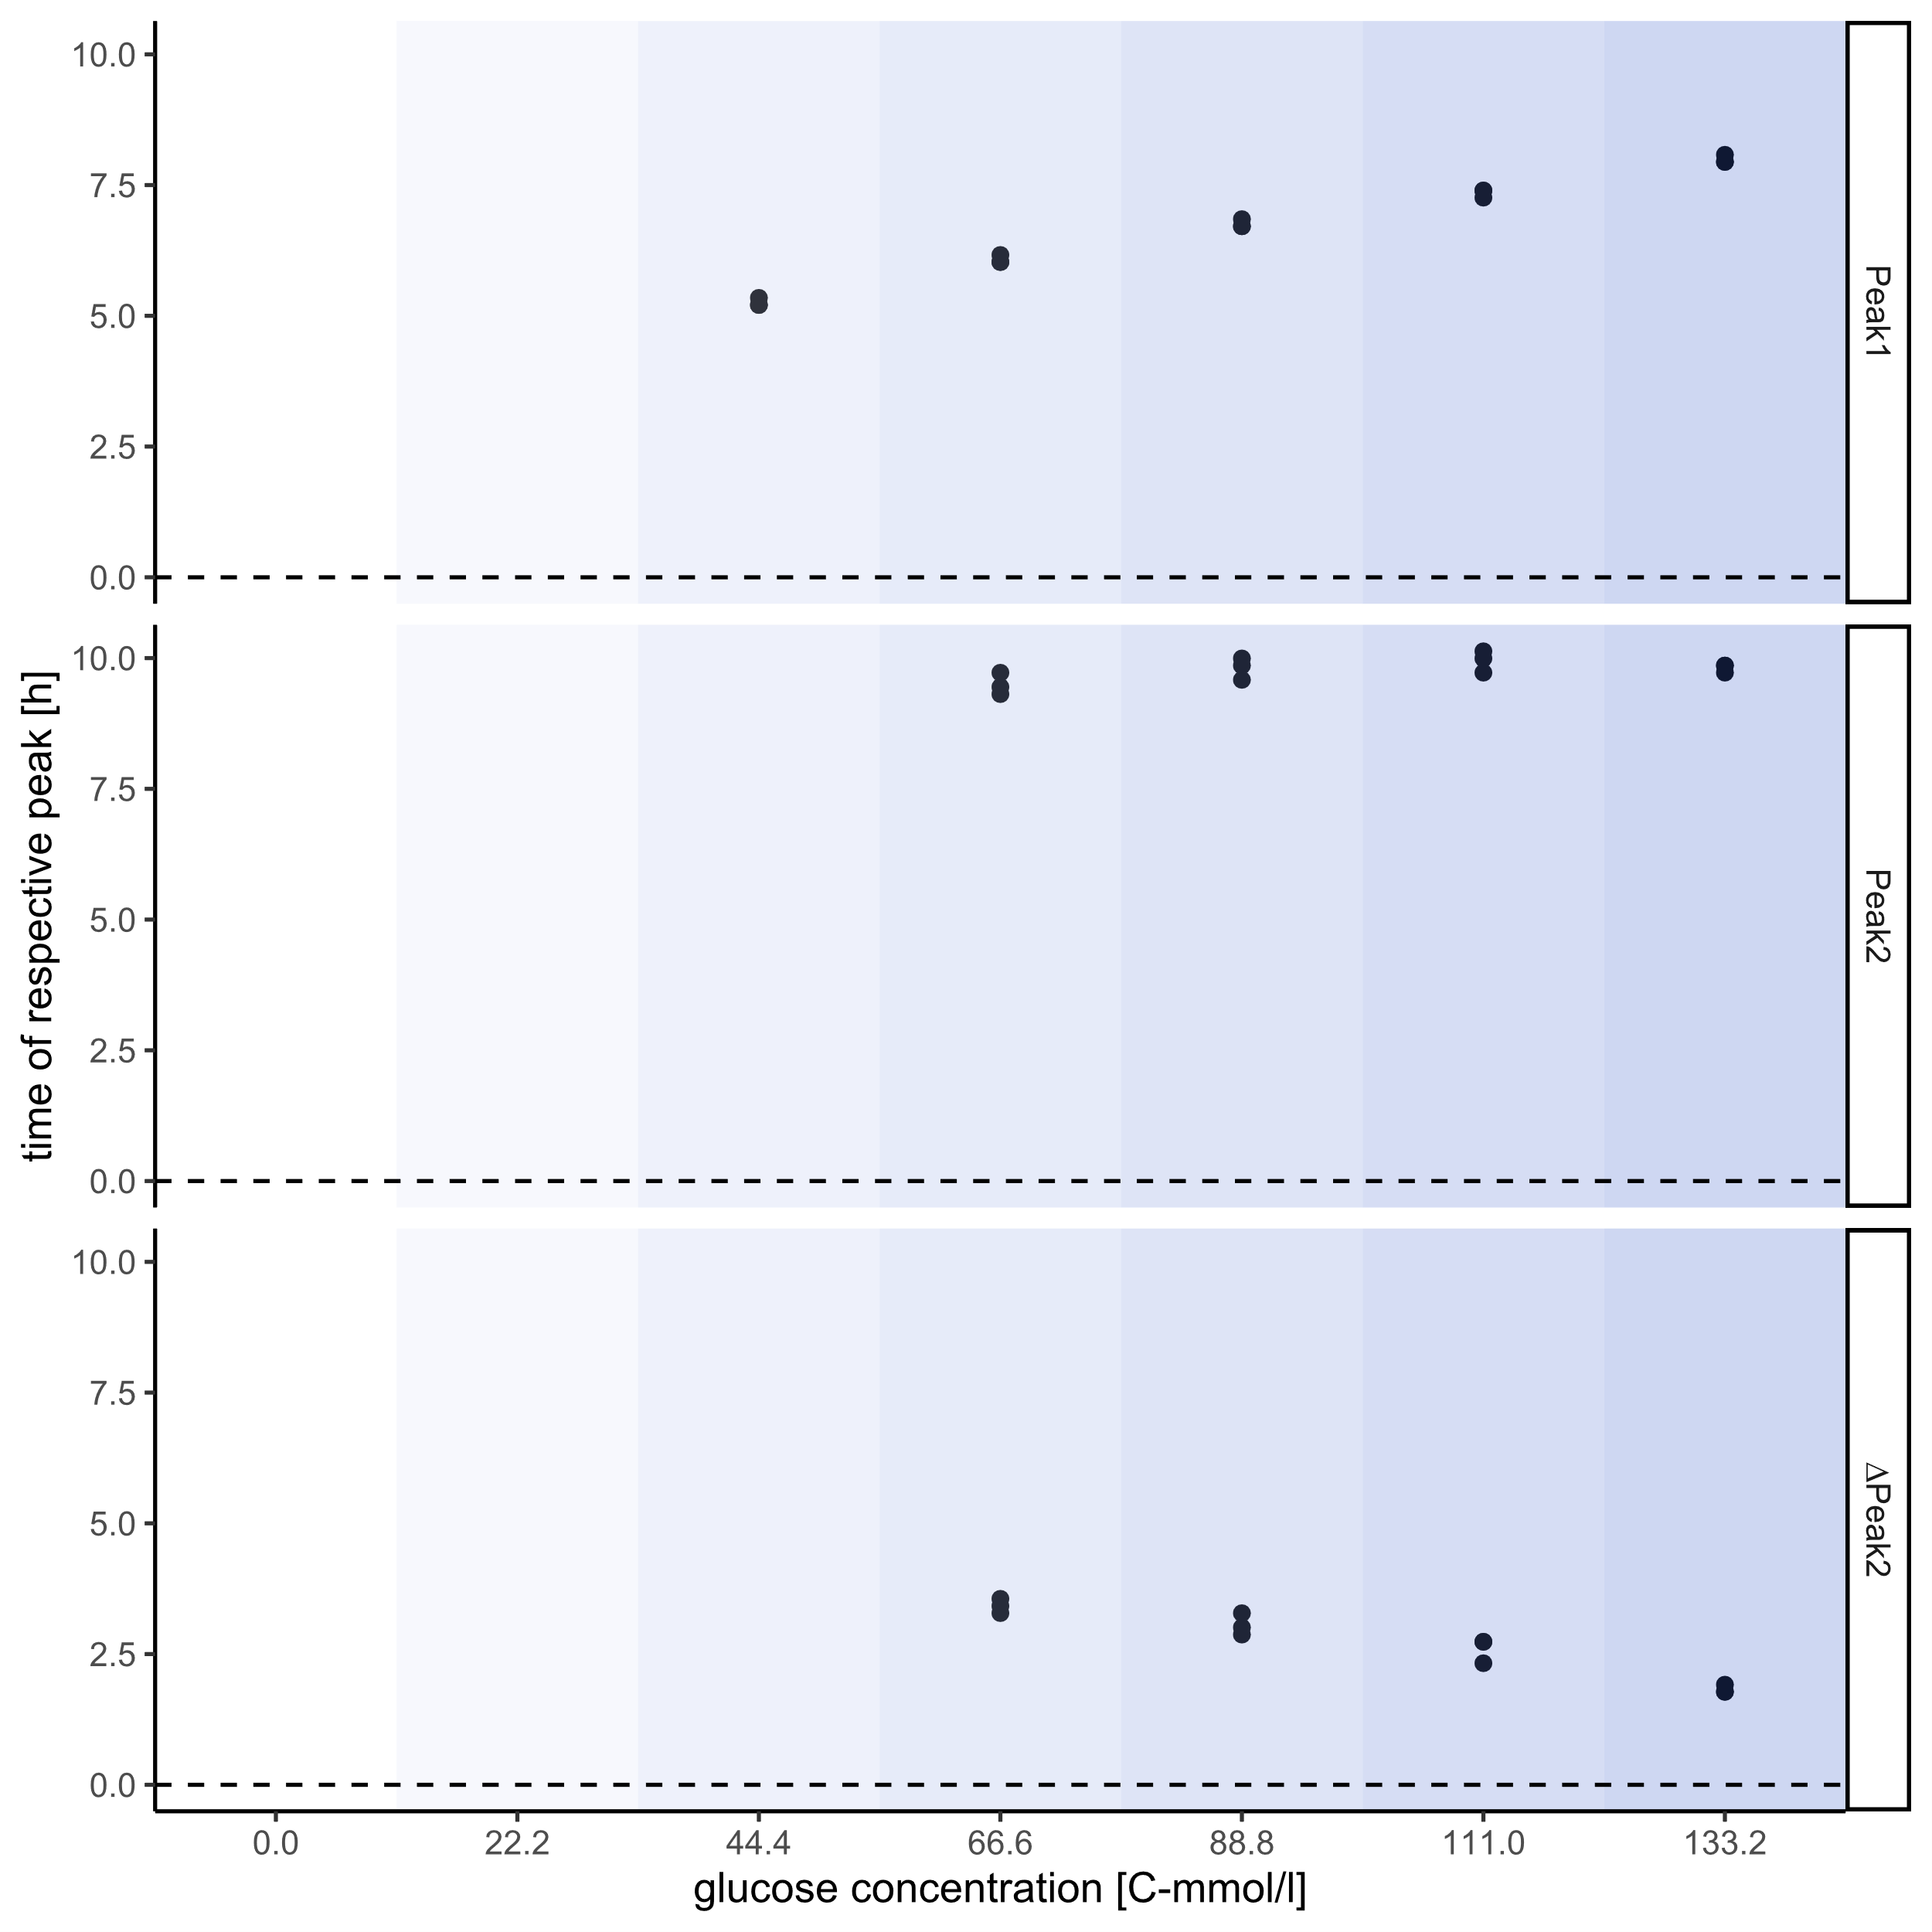
Glucose: Drops
Time of drops vs. glucose concentration
Time of drops
first drop time: + correlation
Second drop time : stable
Drop time difference: - correlation

Slide 9
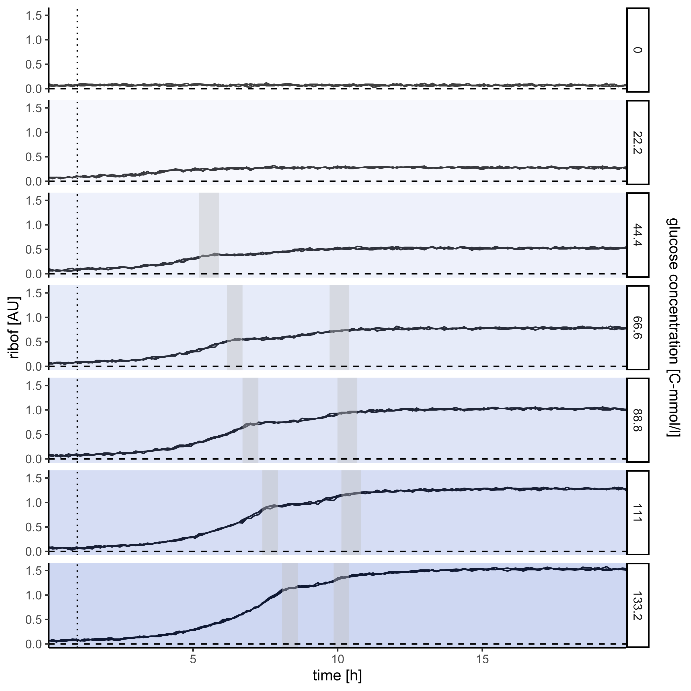
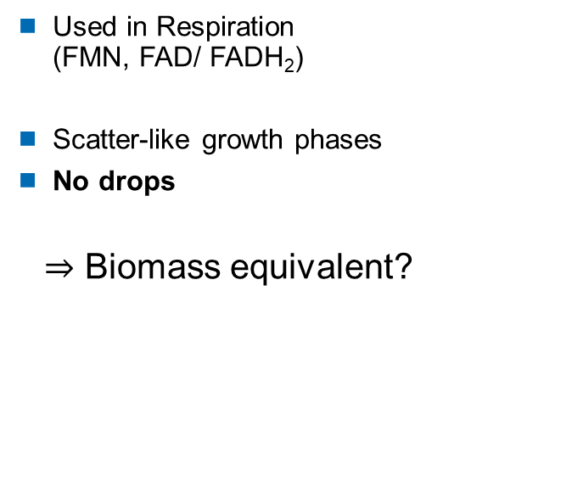
Glucose: Riboflavin
Riboflavin vs. time
Scatter alternative?
Used in Respiration (FMN, FAD/ FADH₂)
Scatter-like growth phases
No drops
$⇒$ Biomass equivalent?

Slide 10
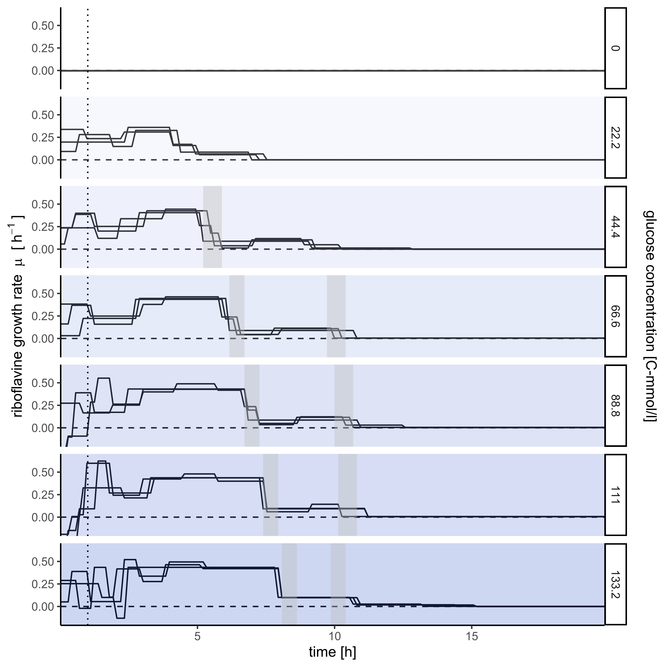
Glucose: Riboflavin
Riboflavin growth rate vs. time
Scatter alternative?
Two growth phases
Initially rising rate (?)
Growth rates mostly stable
Rate change at drop points

Slide 11
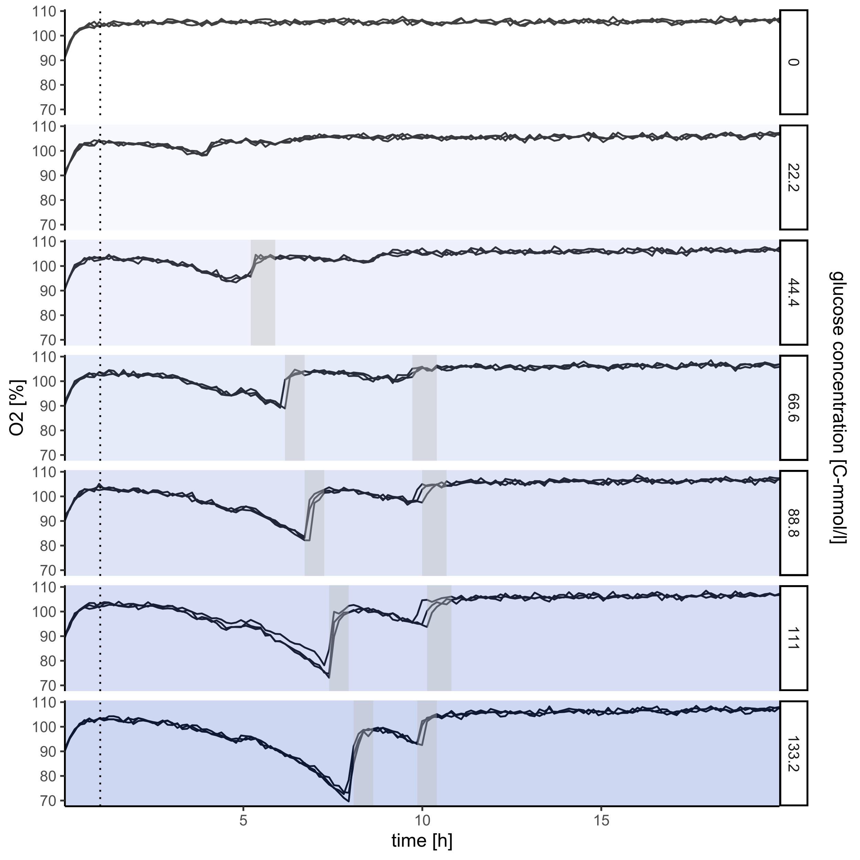
Glucose: O₂
O₂ saturation vs. time
Respiration
Lowered saturation during both phases
Rising saturation during drops

Slide 12
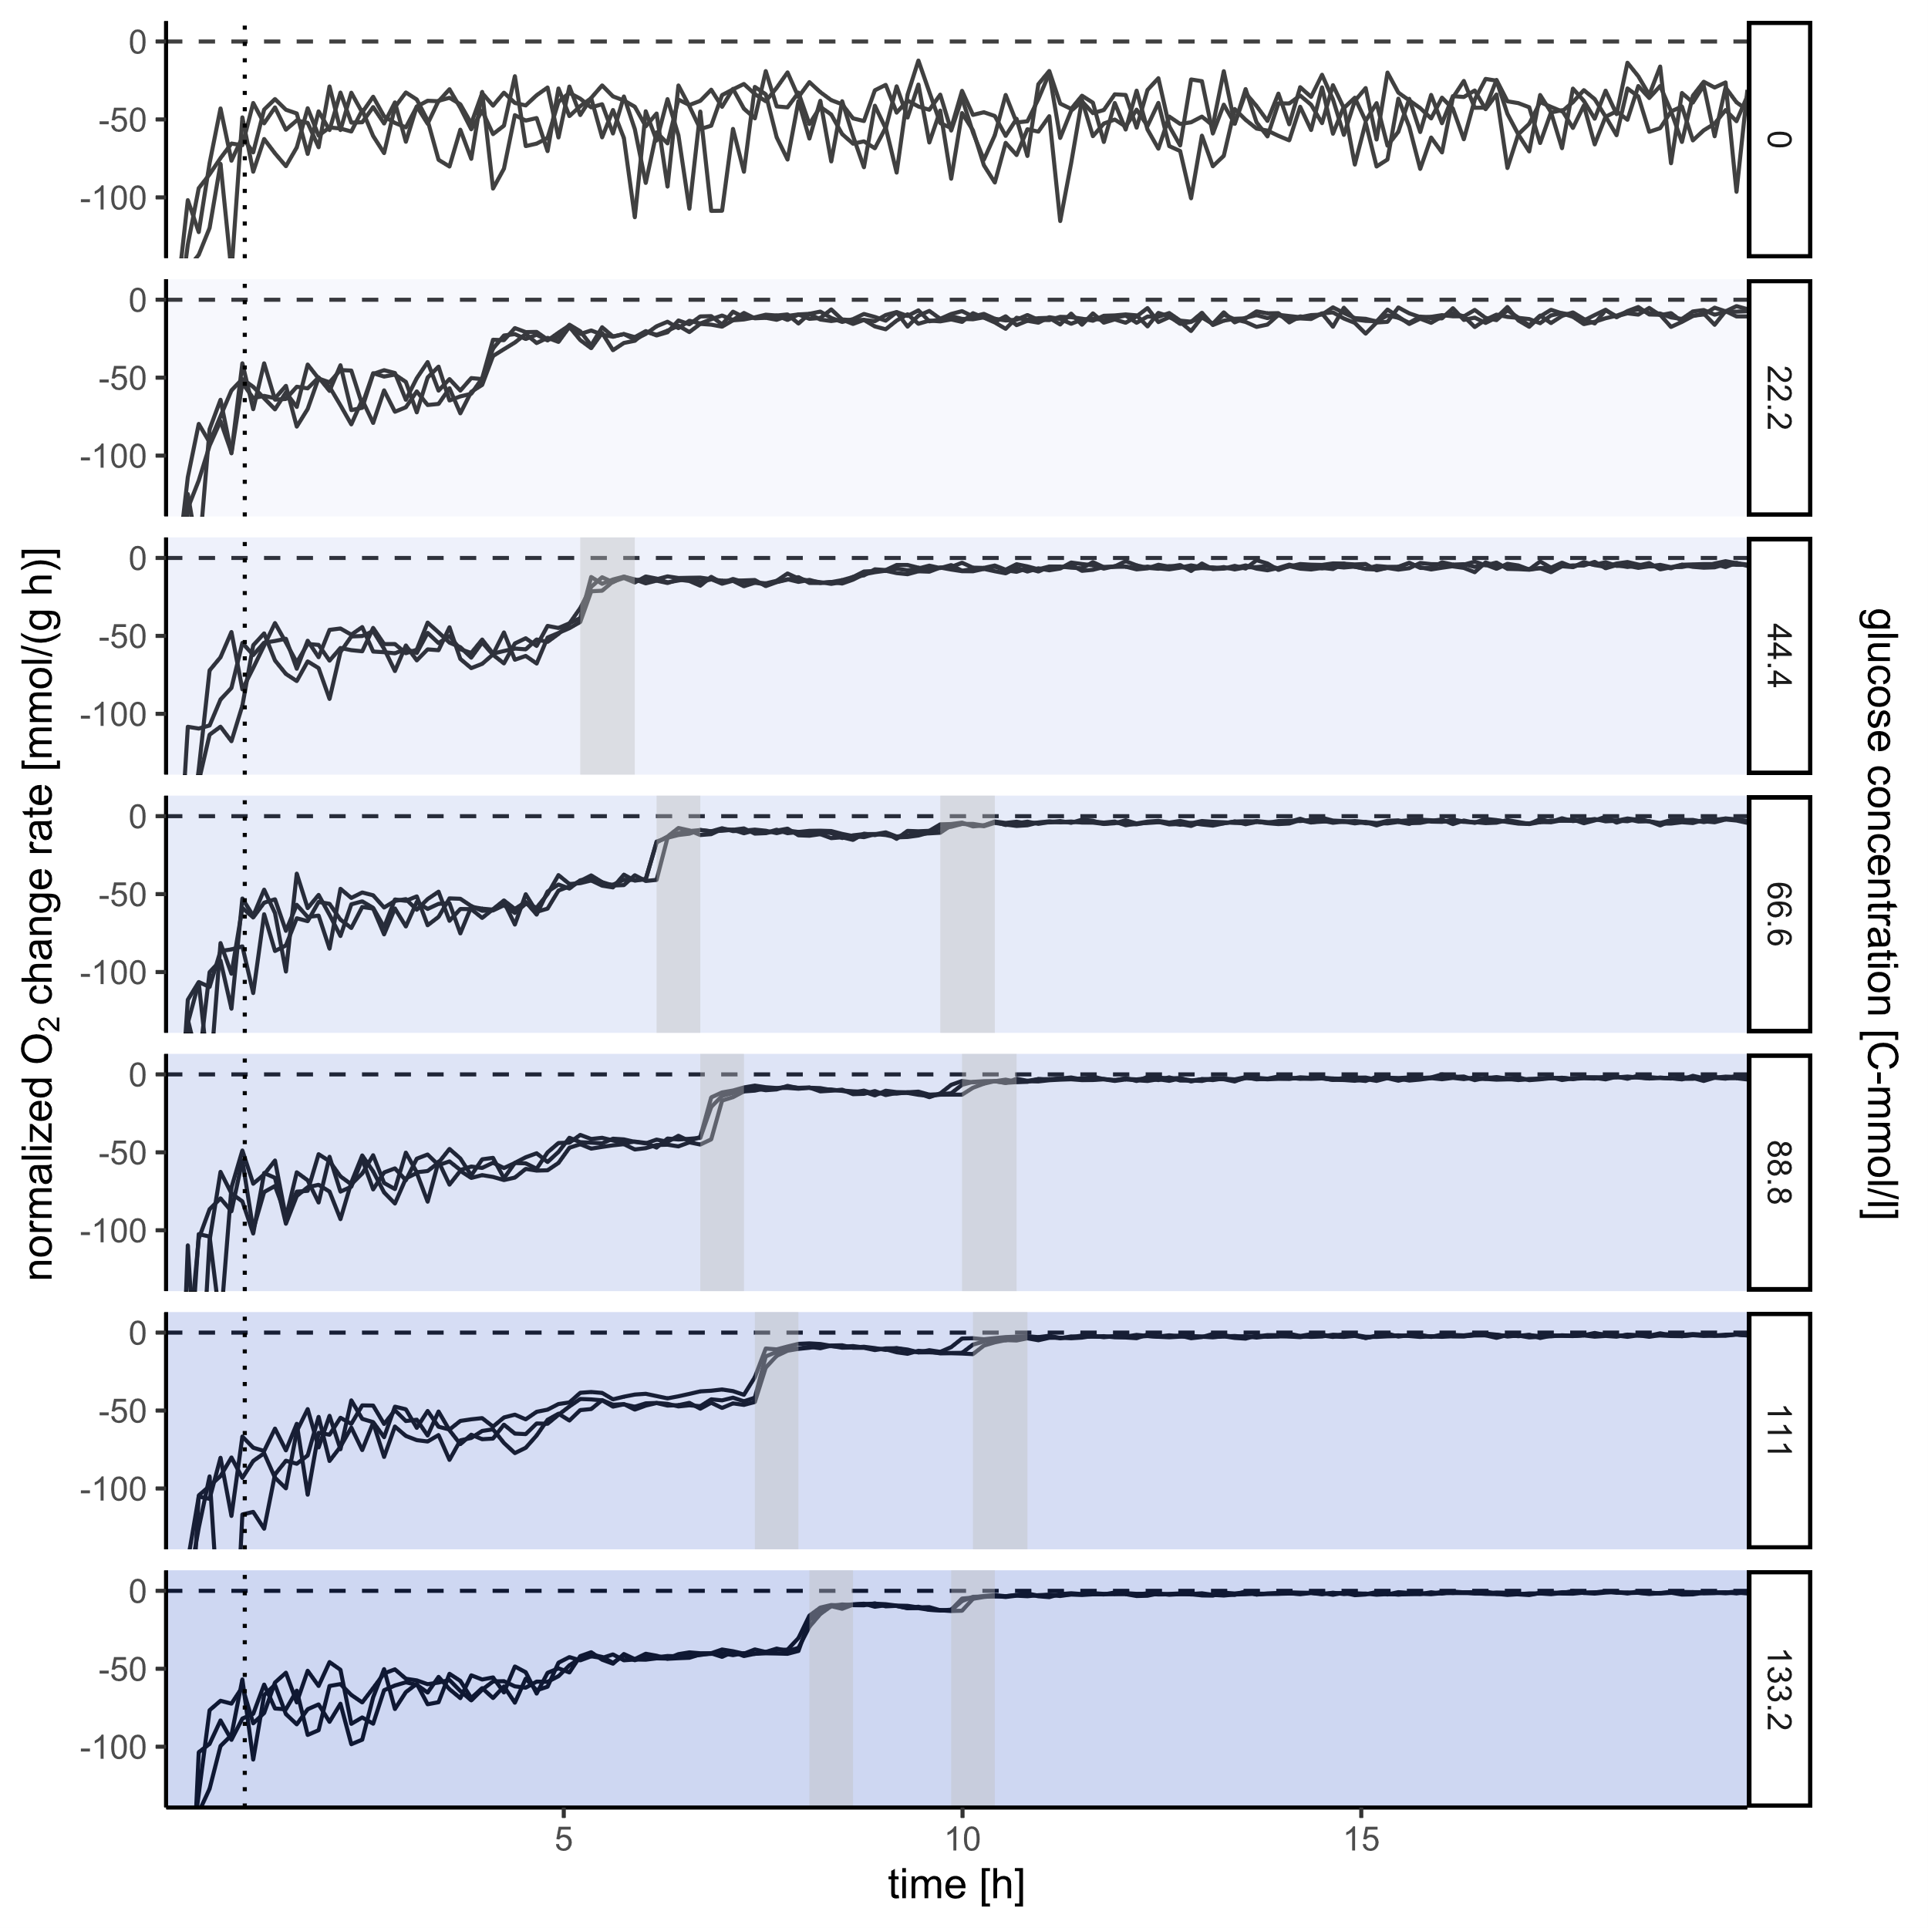
Glucose: O₂
(BM-norm) O₂ change rate vs. time
Biomass normalized respiration
Stable consumption rates in both phases
Second phase rate drastically lower
Drop in consumption during scatter drops
Initial phase?

Slide 13
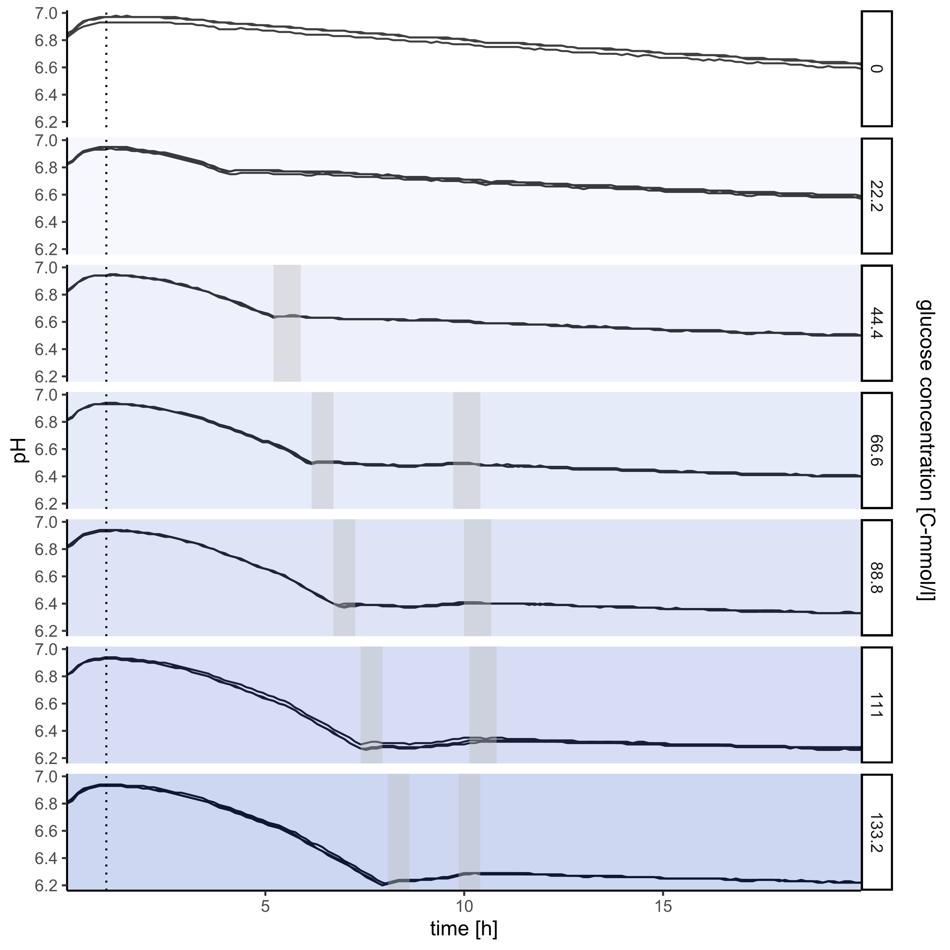
Glucose: pH
pH vs. time
Acidification
Strong acidification in first phase
Small, variable change in second phase
Even cells without glucose acidify

Slide 14
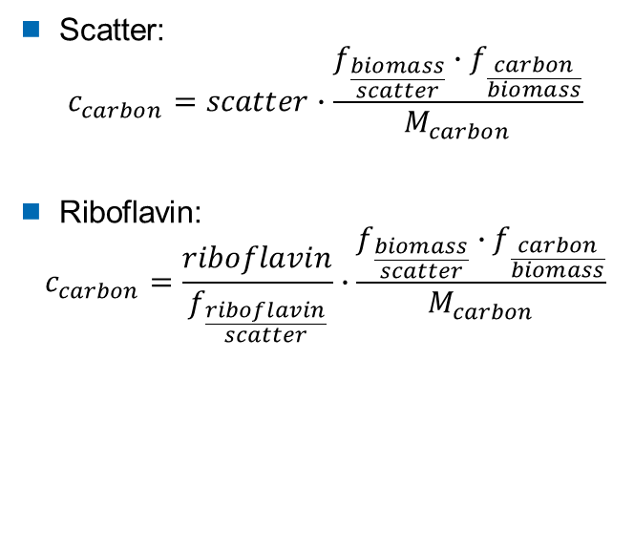
Supportive measurement
Drymass
Expected Biomass
Highest glucose concentration
Samples time series over 7 h
Dry 5 ml on filters: measure weight before and after
Scatter:
$$c_{carbon}=scatter∙\frac{f_{\frac{biomass}{scatter}}∙f_{\frac{carbon}{biomass}}}{M_{carbon}}$$
Riboflavin:
$$c_{carbon}=\frac{riboflavin}{f_{\frac{riboflavin}{scatter}}}∙\frac{f_{\frac{biomass}{scatter}}∙f_{\frac{carbon}{biomass}}}{M_{carbon}}$$

Slide 15
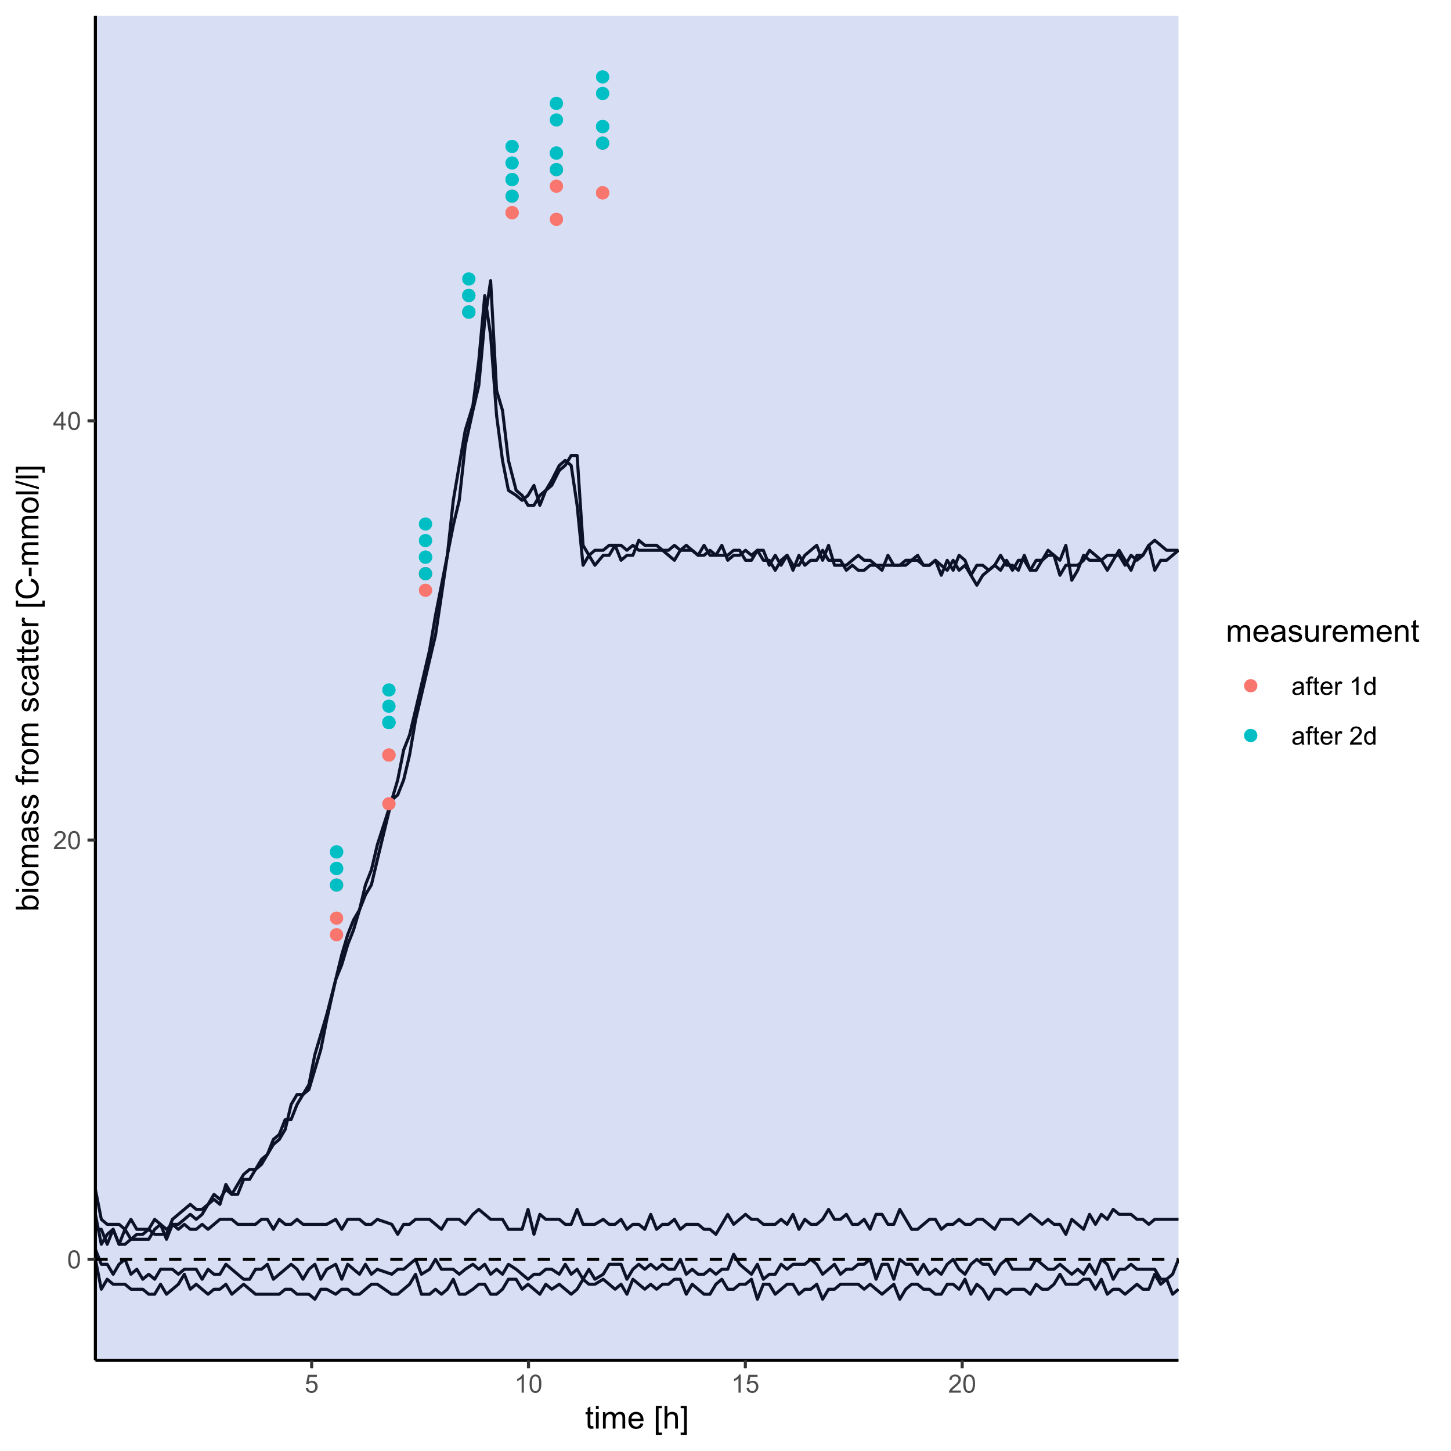
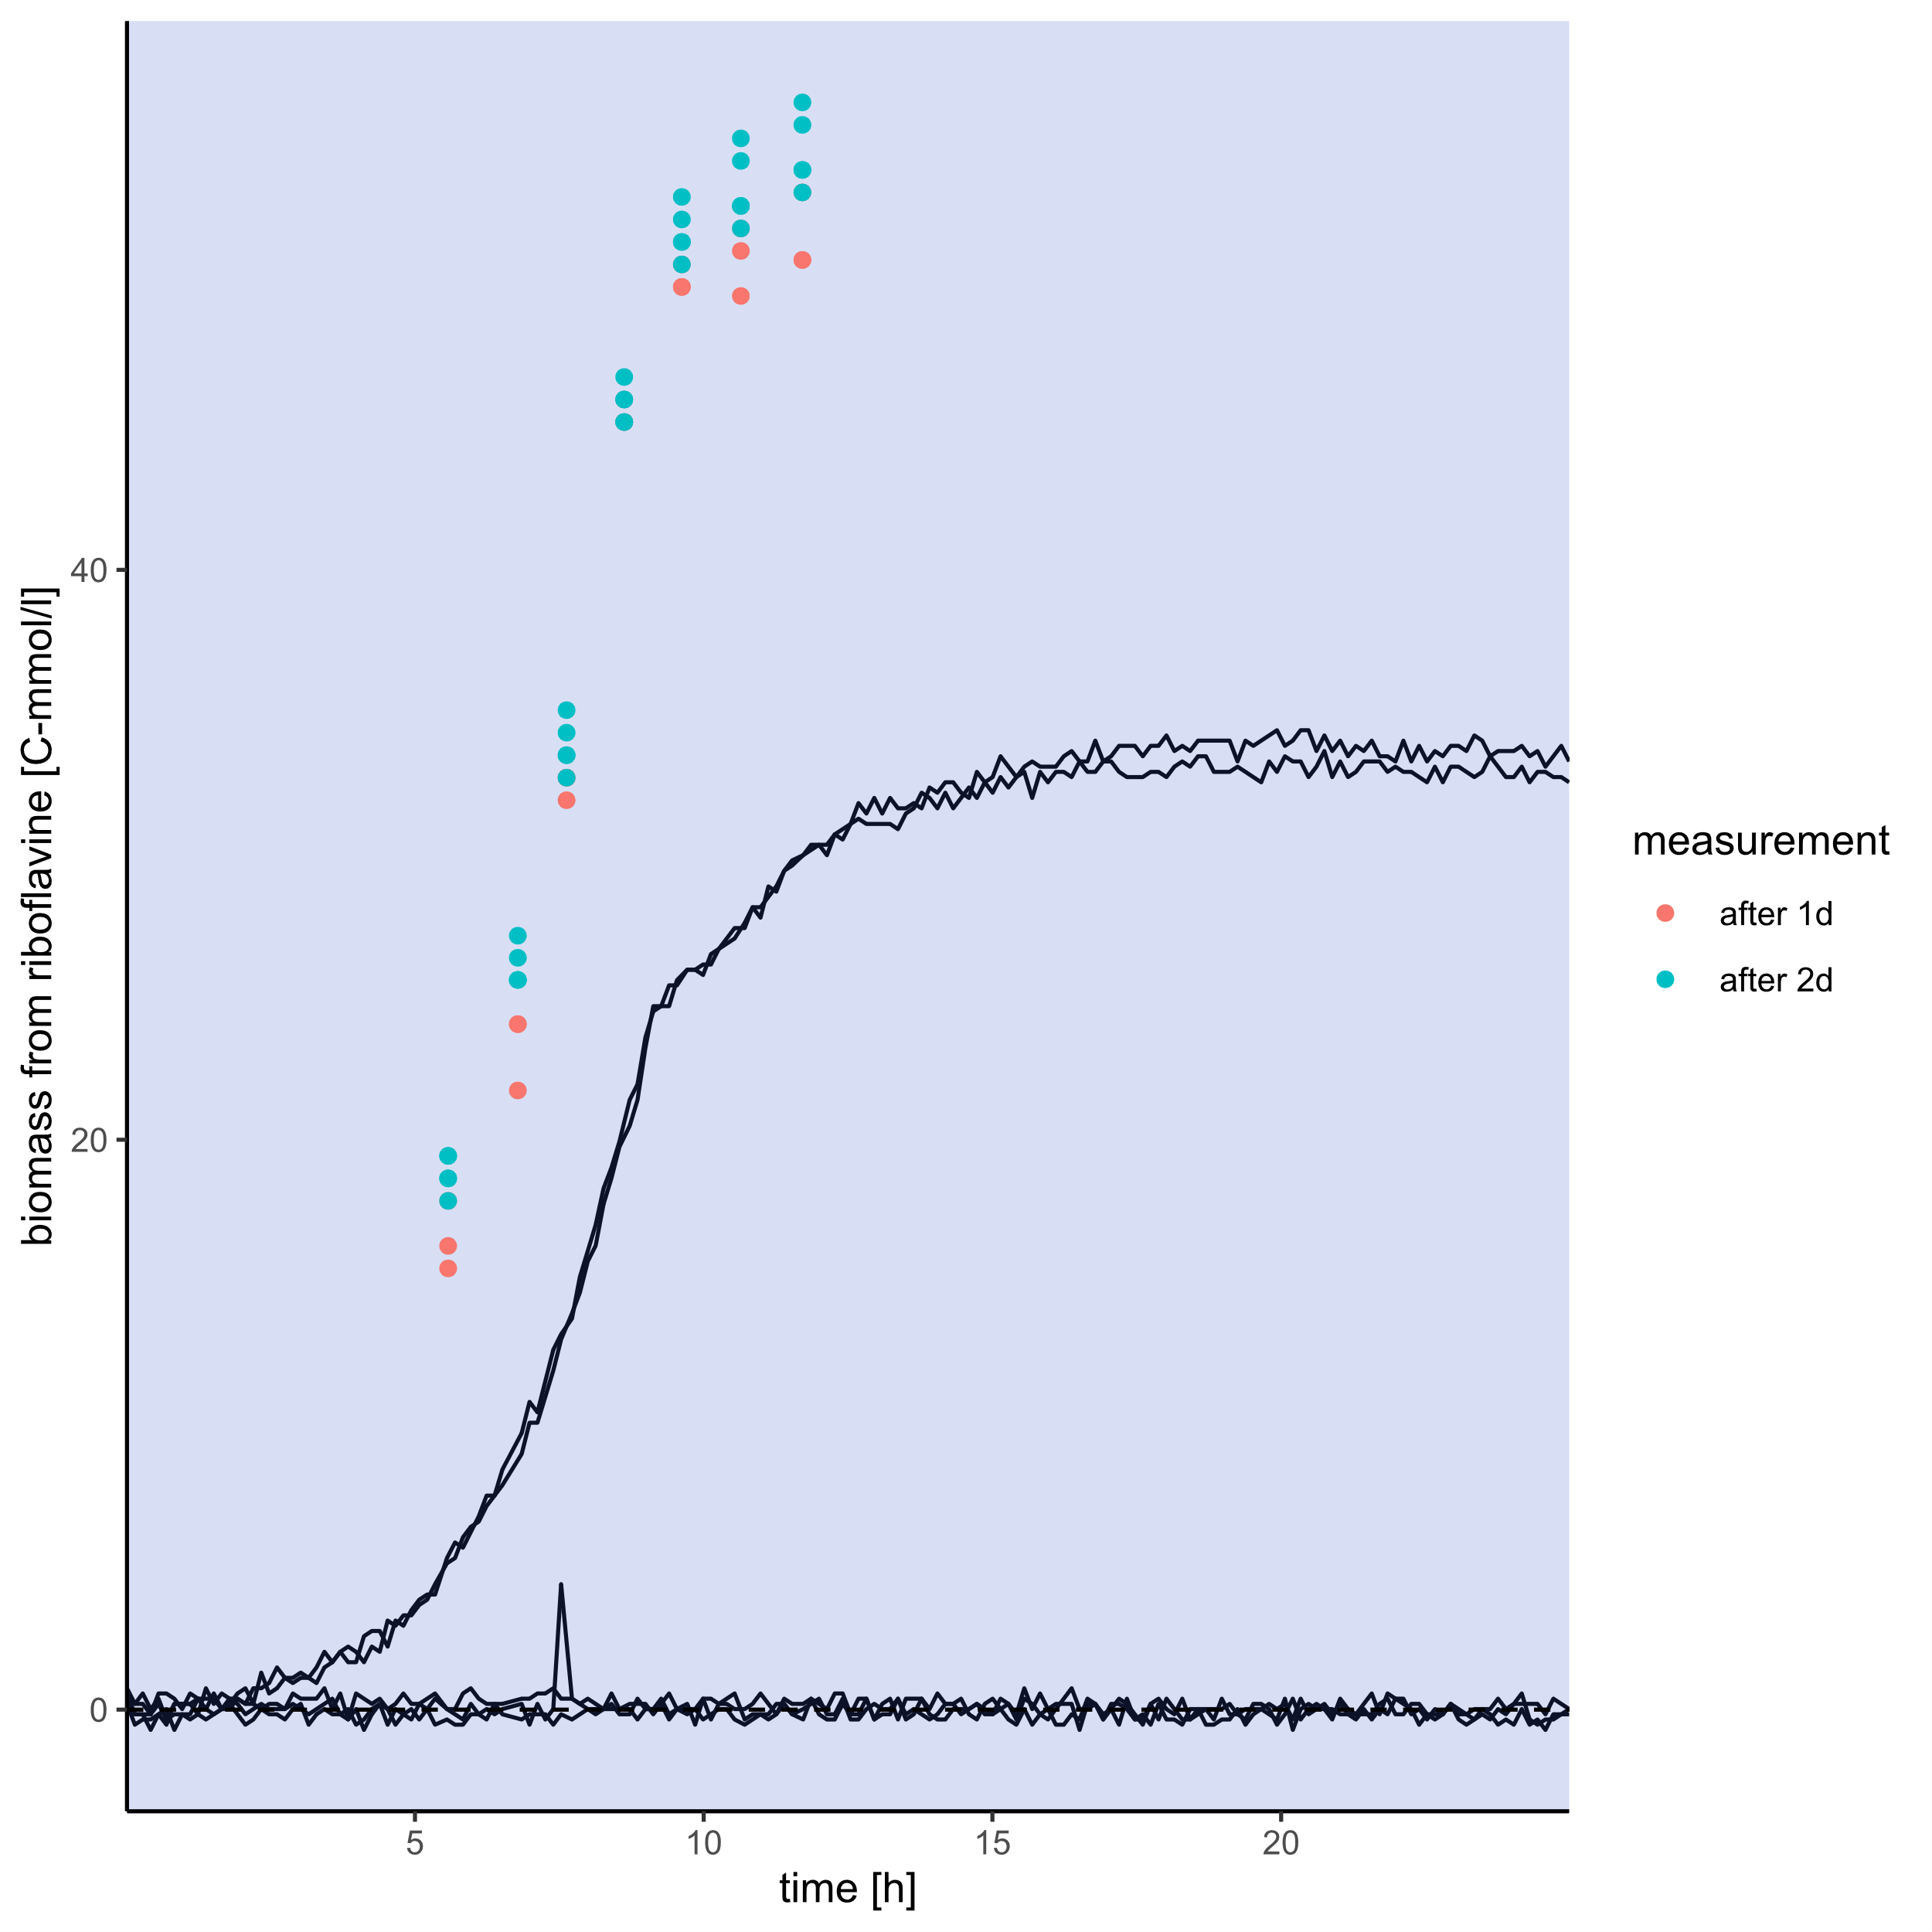
Biomass
Drymass+
„Scattermass“ vs. time
„Riboflavinmass“ vs. time
Drymass
Drymass

Slide 16
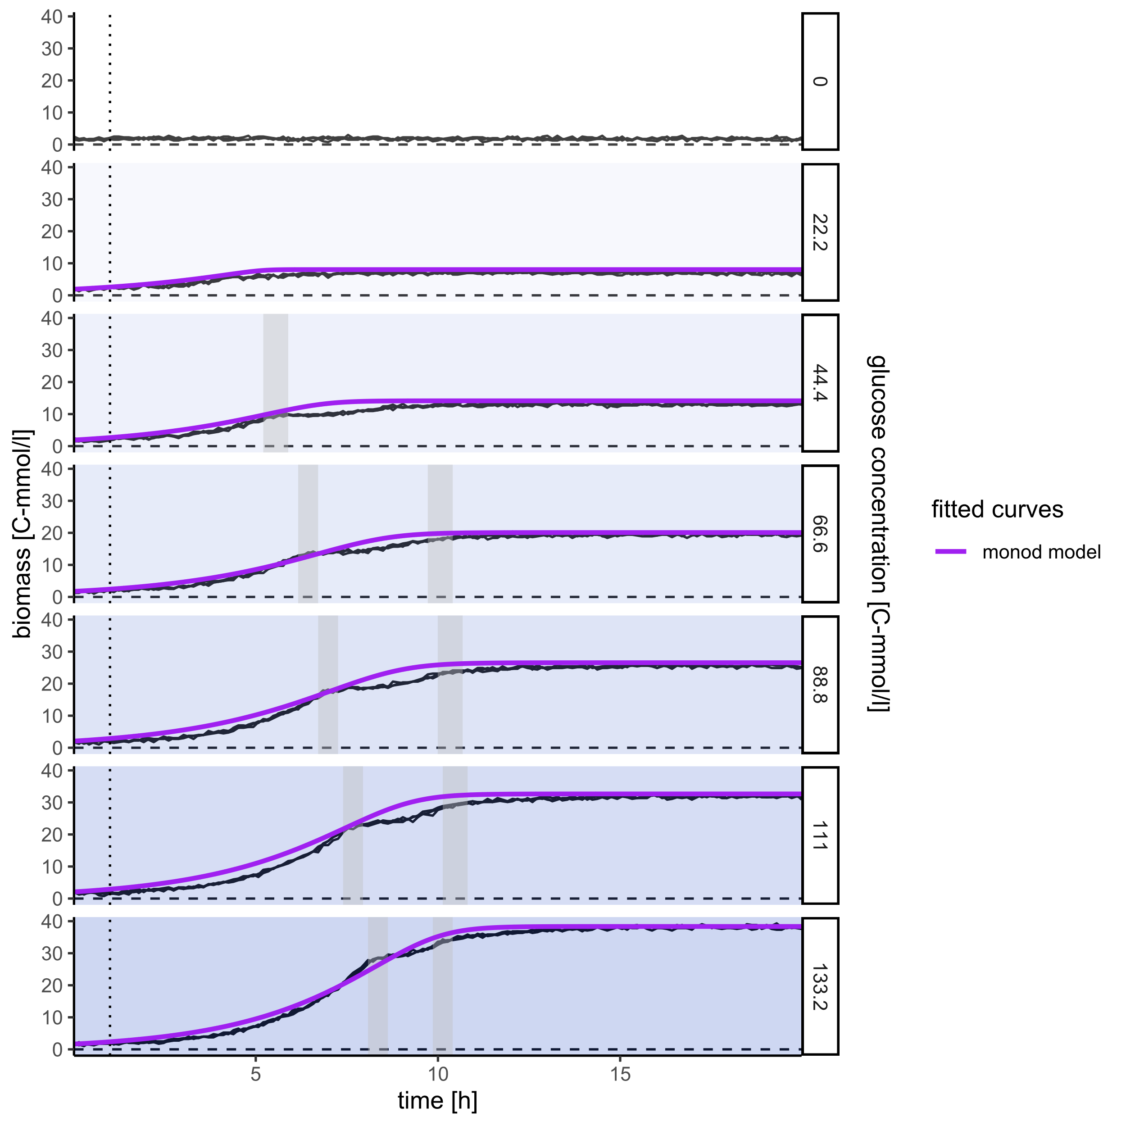
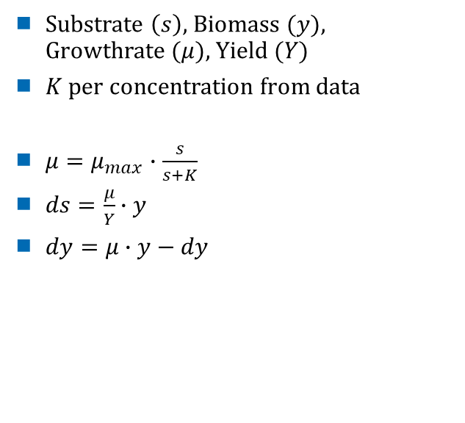
Monod model
Simplest approach
Substrate $\left(s\right),$Biomass $(y)$, Growthrate $(μ)$, Yield $(Y)$
$K$ per concentration from data
$μ=μ_{max}∙\frac{s}{s+K}$
$ds=\frac{μ}{Y}∙y$
$dy=μ∙y−dy$

Slide 17
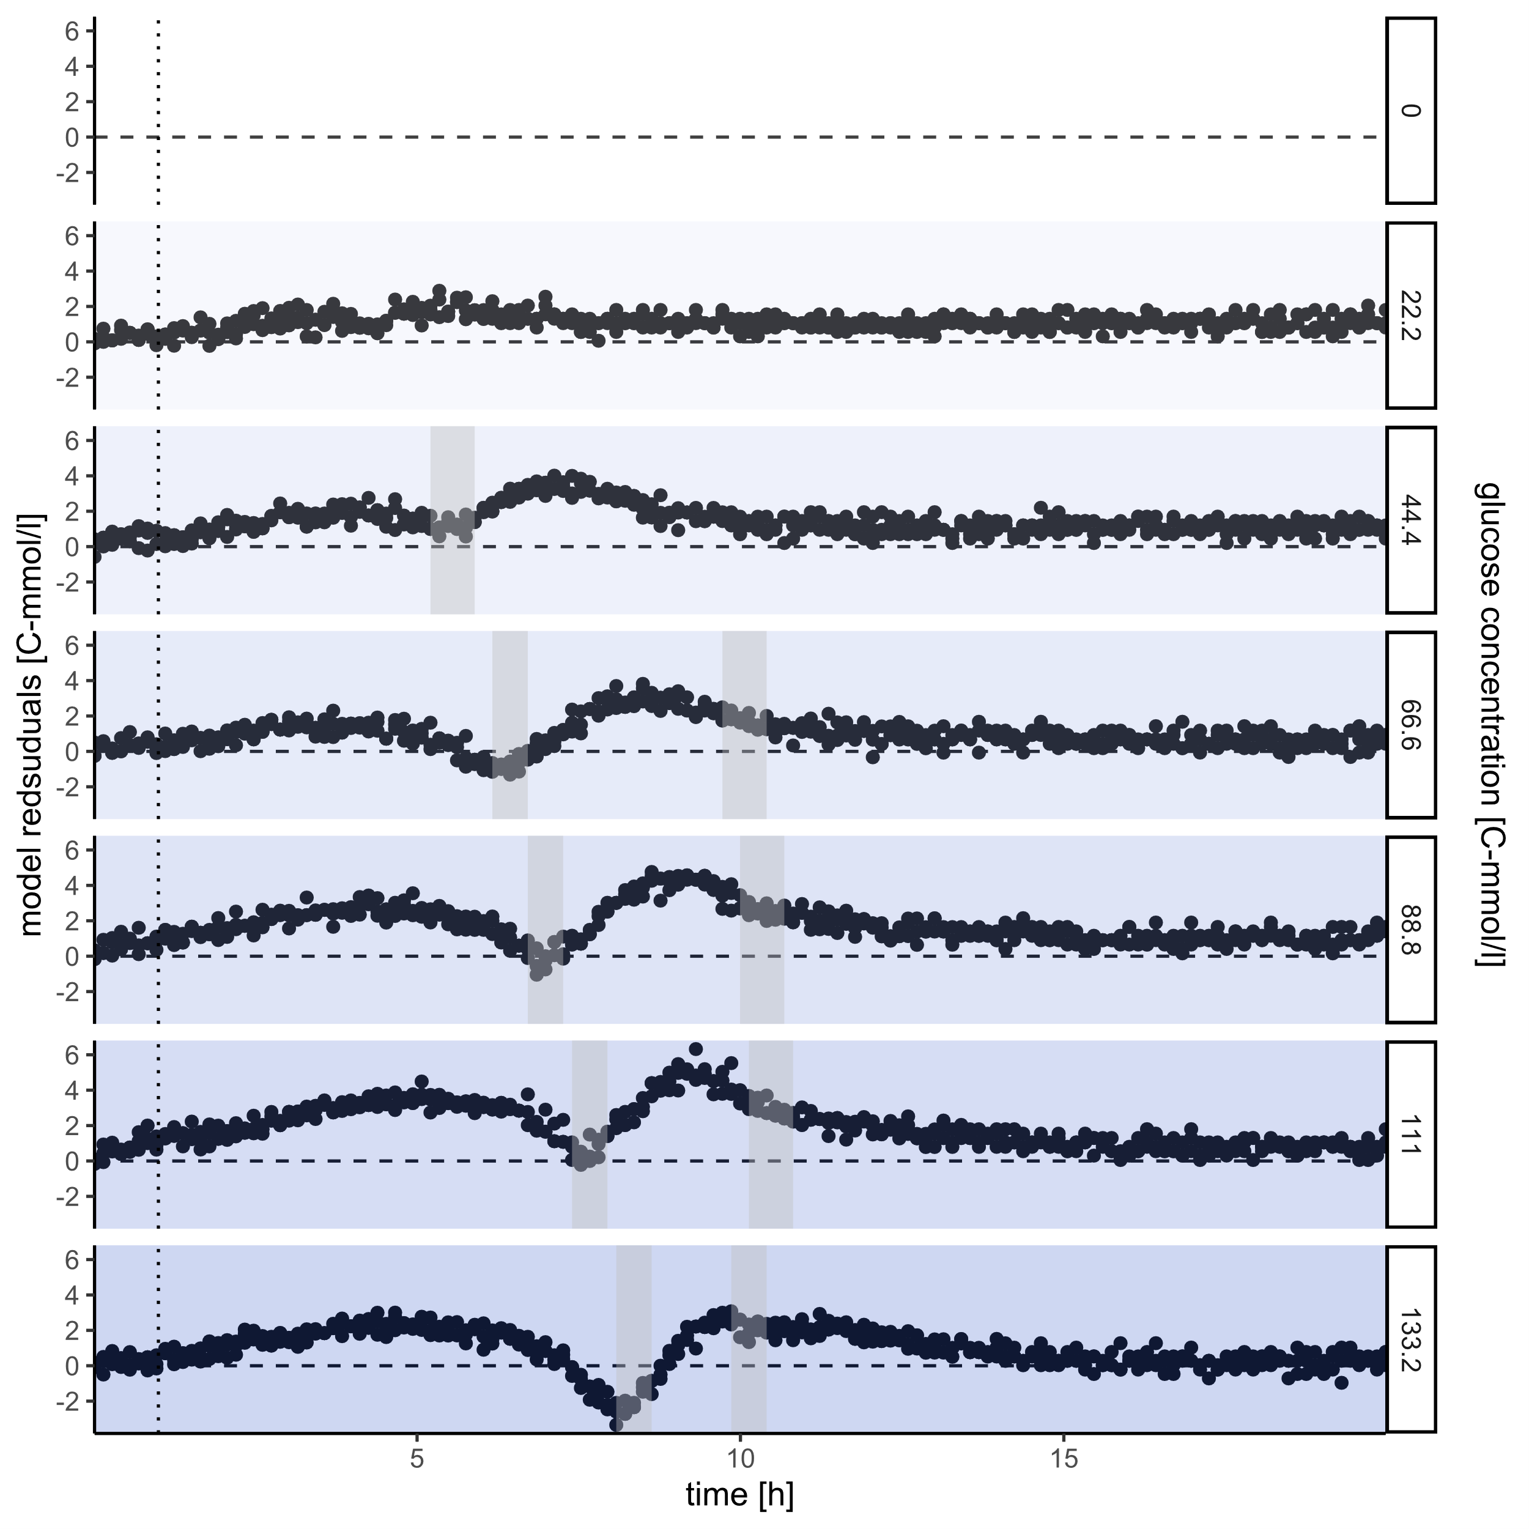
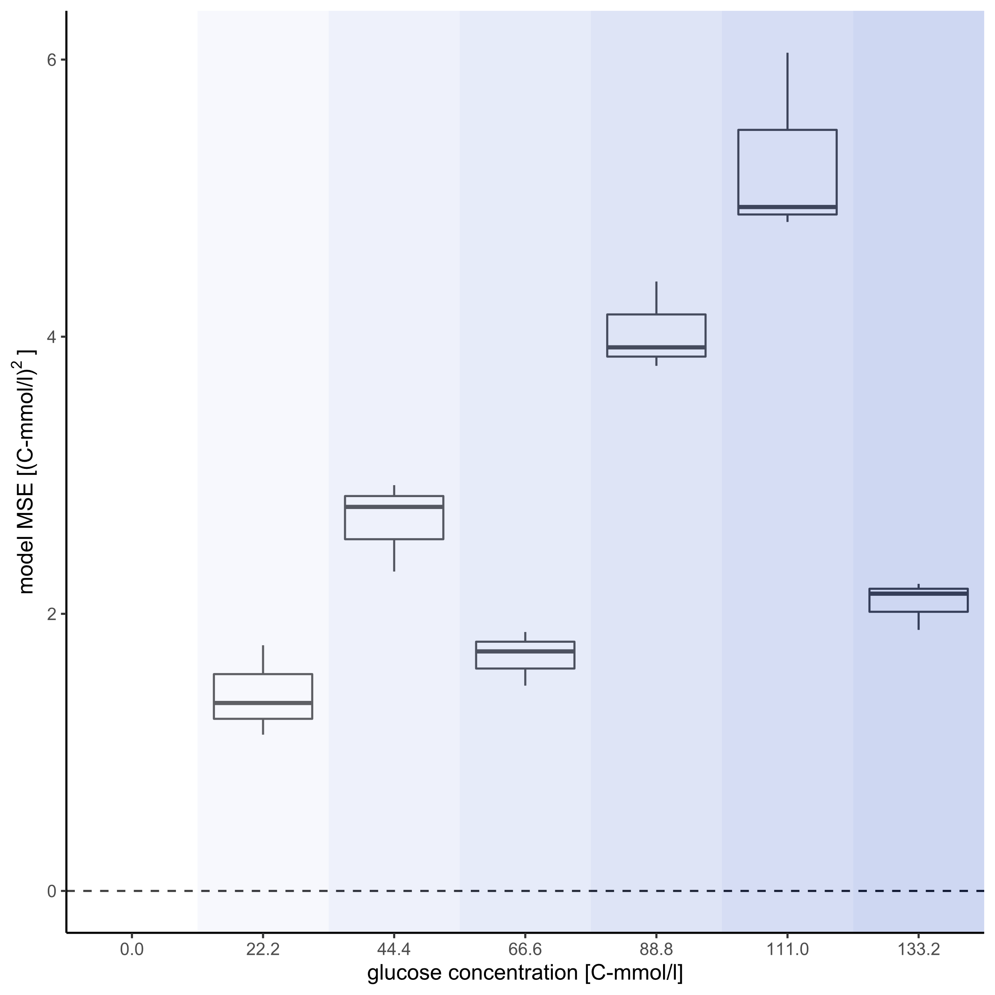
Monod model
Residuals vs. time
MSE vs. concentration

Slide 18
Glucose: Recap
Scatter vs. time
Three phases, separated by drops
Initial growth:
Strong scatter + riboflavin growth
High O₂ usage
Strong acidification
Second growth
Weaker scatter + riboflavin growth
Low O₂ usage
Varying pH
Stationary

Slide 19
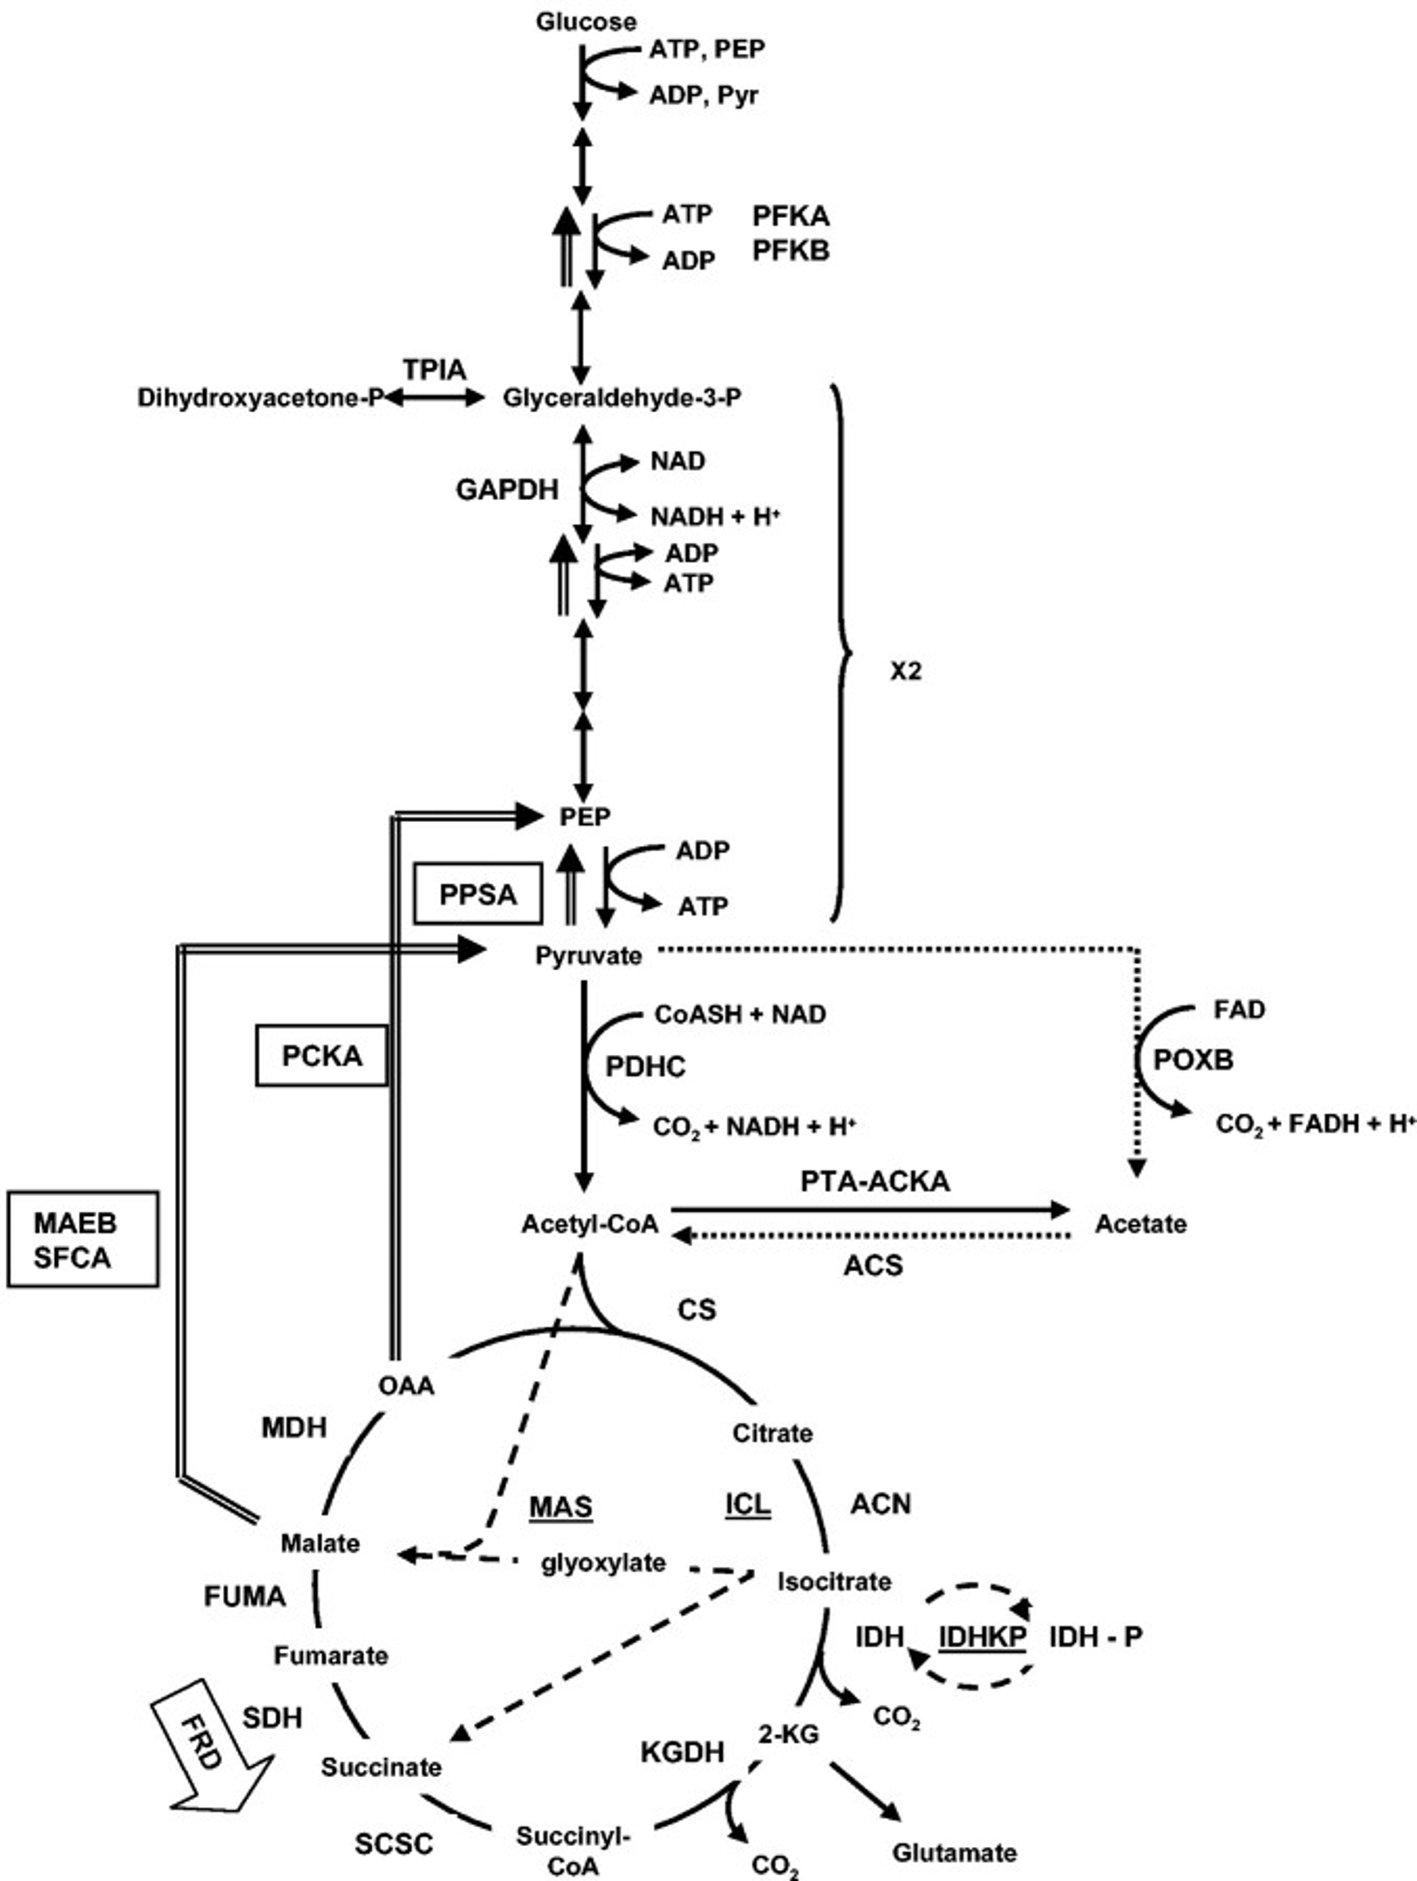
Metabolism
+2 ATP
+2 NADH
(+1 ATP)
+1 NADH
~ 15%
+1 GTP
+3 NADH
+1 FADH₂
Two phases
Wolfe, 2005

Slide 20
Acetate-switch
Metabolism
-2 ATP
Two phases
Wolfe, 2005

Slide 21
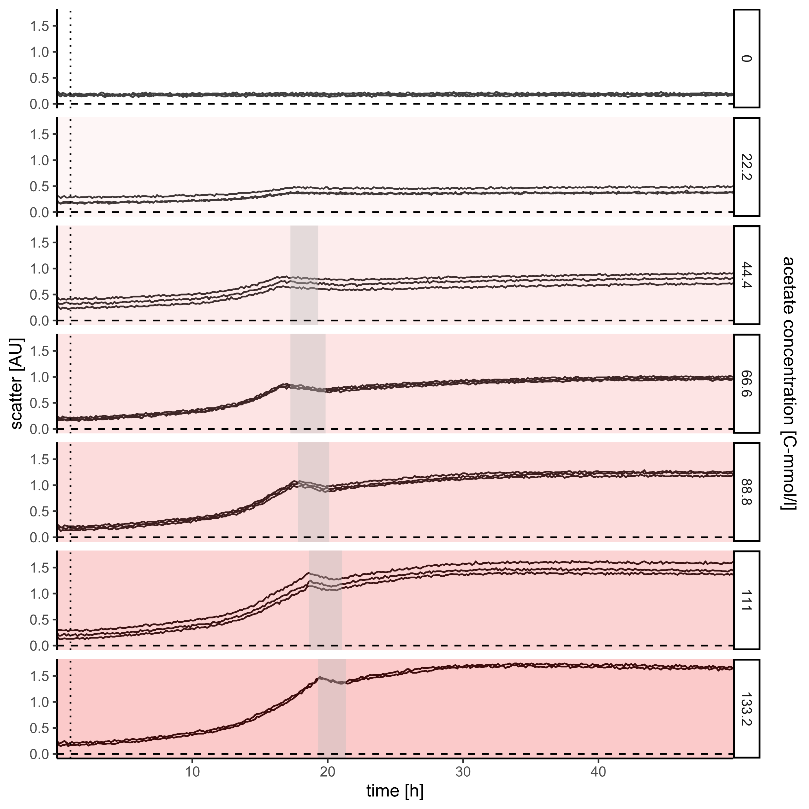
Acetate: Scatter
Scatter vs. time
Surprising growth
Only one drop
Growth after drop

Slide 22
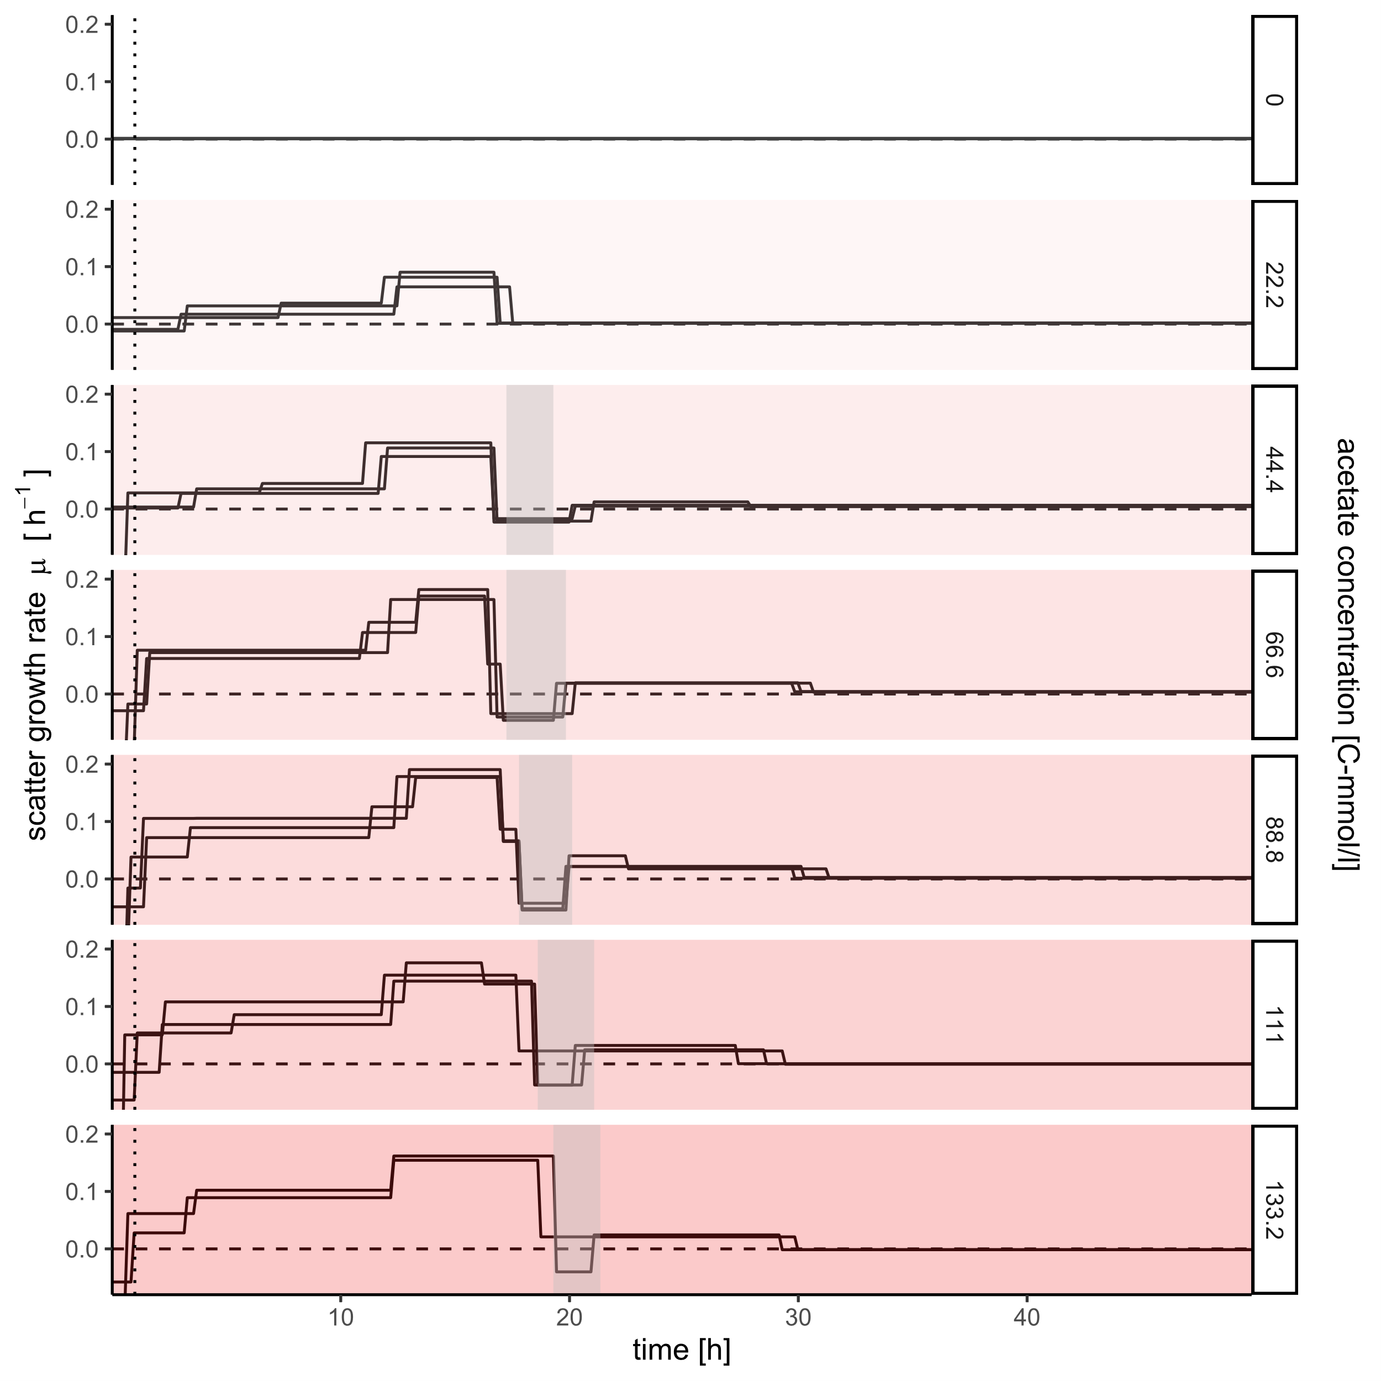
Acetate: Scatter
Scatter growth rates vs. time
Still three phases?
Mostly stable growthrates
Two subphases during growth

Slide 23
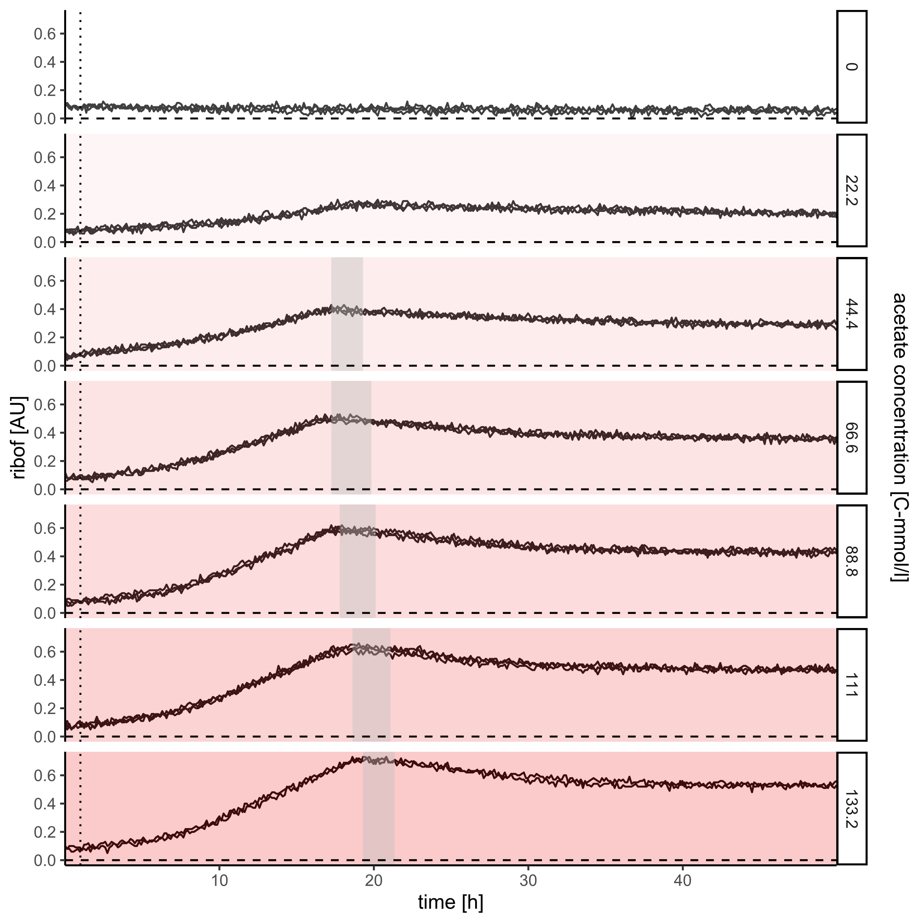

Acetate: Riboflavin
Riboflavin vs. time
Mass decay?
No sudden drop
But peak with following decay
$⇒$ Riboflavin and scatter disagree

Slide 24
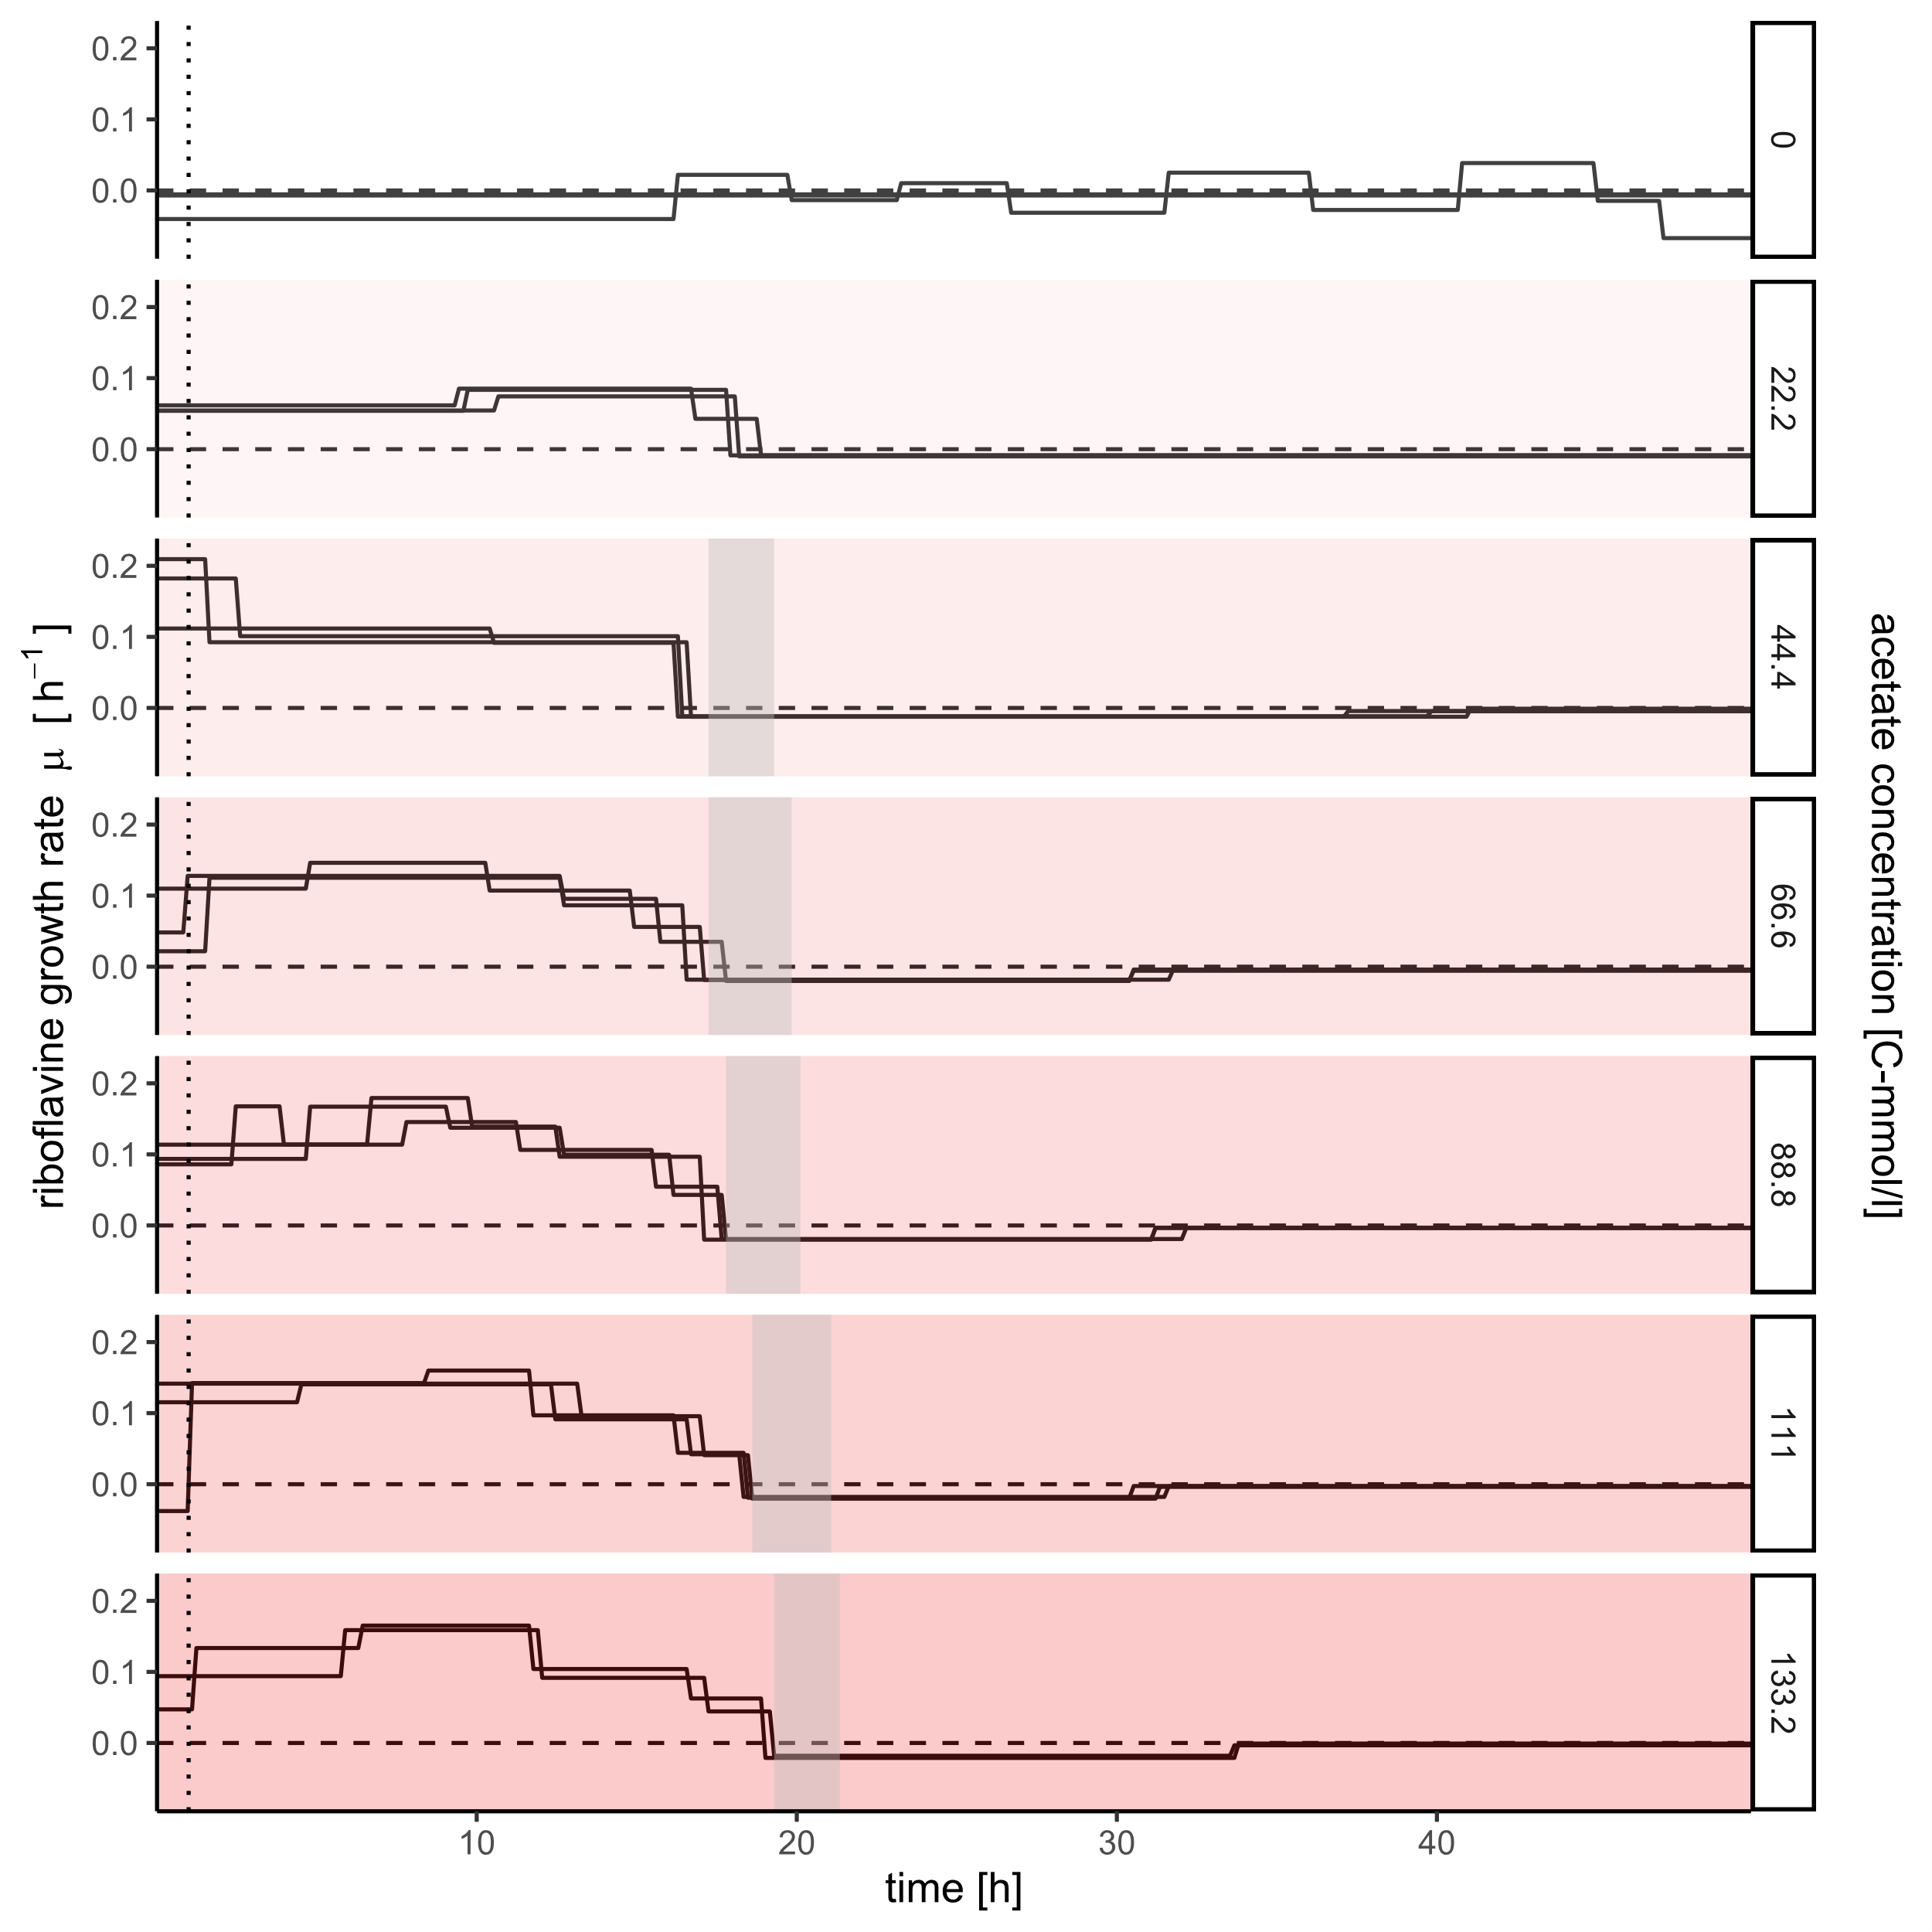
Glucose: Riboflavin
Riboflavin growth rate vs. time
Decay
Only one growth phase
But gradually decreasing rate
Constant decay starting with drop

Slide 25
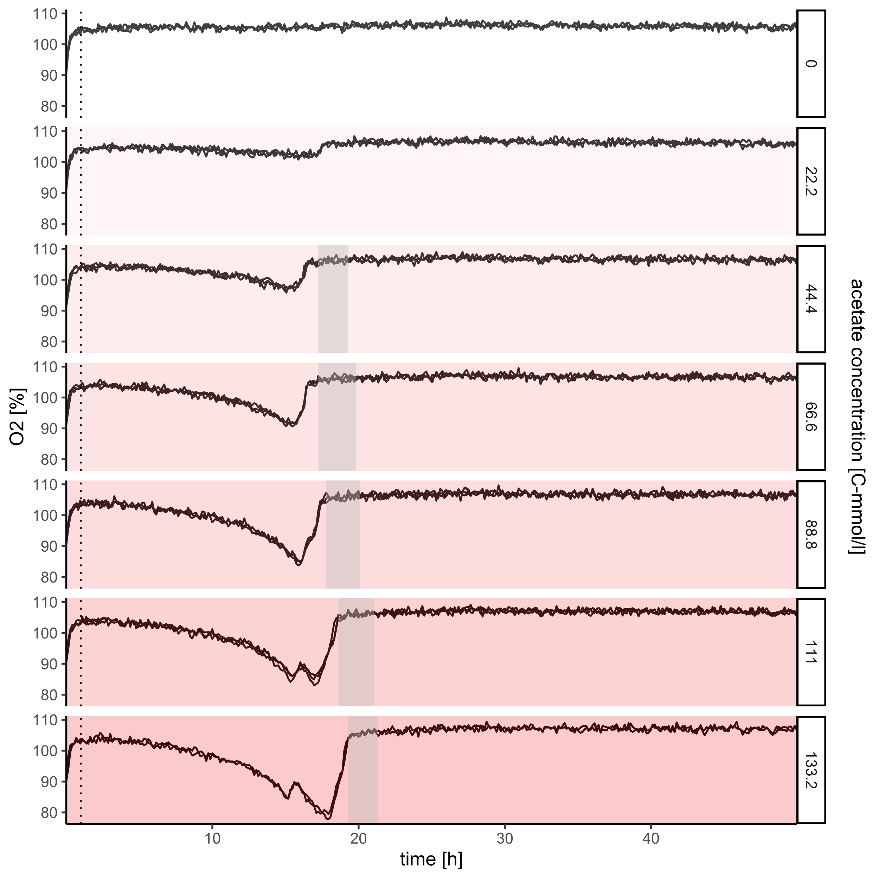
Acetate: O₂
O₂ saturation vs. time
Respiration
O₂ consumption only during growth
Consumption stops before scatter drop
“Dip” in usage for high concentrations

Slide 26
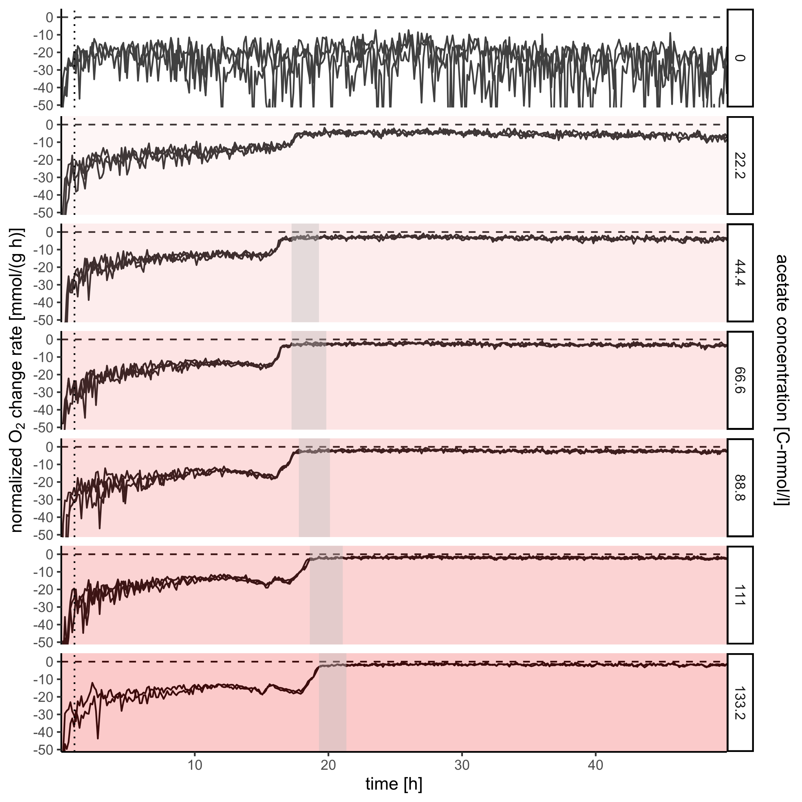
Glucose: O₂
(BM-norm) O₂ change rate vs. time
Biomass normalized respiration
Mostly stable consumption in both phases
“Dip” in usage for high concentrations

Slide 27
Future outlook
Higher complexity
Fit more complex models
Include metabolic structure
Determine Biomass equivalent
Investigate Acetate behavior

Slide 28


Thanks for listening
Acknowledgements
Tim Petzel
Nikolaus Thumm
Rainer Machne
Oliver Ebenhöh
Ilka Axmann
And everyone in SynMibi and QTB for having me

Slide 29
References
Bruce Alberts et al. Molecular biology of the cell. 3rd edition. 1994. ISBN: 0-8153-1619-4.
James Patrick Folsom and Ross P. Carlson. “Physiological, biomass elemental composition and proteomic analyses of Escherichia coli ammonium limited chemostat growth, and comparison with iron- and glucose-limited chemostat growth”. In: Microbiology (United Kingdom)161.8 (2015), pp. 1659–1670. ISSN: 14652080. DOI: 10.1099/mic.0.000118.
A. J. Wolfe. “The Acetate Switch”. In: Microbiology and Molecular Biology Reviews 69.1 (2005), pp. 12–50. ISSN: 1092-2172. DOI: 10.1128/mmbr.69.1.12-50.2005.

